Slide 1
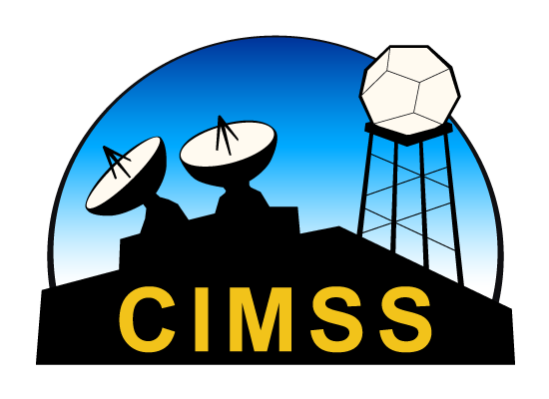

CIMSS Global Direct Broadcast Application Workshops
Fostering the Next Generation of Scientists
Jessica Braun
Liam Gumley, Kathy Strabala
CSPP Users’ Group Meeting 2019
26 June 2019

Slide 2
Overview
History
Methodology
HYDRA2 Analysis Toolkit
HYDRA2 Examples
Lab Examples
Are they useful?
Conclusions

Slide 3
History
The Cooperative Institute for Meteorological Satellite Studies (CIMSS) at the Space Science and Engineering Center (SSEC) has a long history of providing educational outreach and training
1980s – The start of Remote Sensing Seminars – led by Bill Smith.
2001 – Extended (10 day) Remote Sensing Seminars by Paul Menzel and Paolo Antonelli.

Slide 4
Timeline of DB Workshops
2004 – Nanjing, China; Perth, Australia
2005 – Taipei, Taiwan; Beijing, China
2006 – Andenes, Norway; Pretoria, South Africa
2007 – Cachoeira Paulista, Brazil (as part of GEOSS)
2009 – Stellenbosch University, South Africa
2011 – Shanghai, China; Citeko, Bogor,Indonesia
2013 – Honolulu, HI, USA
2015 – Miami, FL, USA
2016 – Mayaguez, Puerto Rico; Korea (part of AOMSUC-7); Moscow, Russia
2017 – Hampton, VA, USA; Vladivostok, Russia (part of AOMSUC-8)
2018 – Tiyan, Guam; Jakarta, Indonesia (part of AOMSUC-9)
Notes:
12 different countries

Slide 5
Methodology
Series of lectures and specialized labs catered to workshop location and students needs/interest.
First day reviews instrument sensors, channels
  Main focus is use of MODIS and VIIRS.
  Introduces students to HYDRA2 toolkit.
Following Lectures build concepts about Level 2 derived products that are applied during labs.

Slide 6
Methodology
Final Day focuses on group case studies.
  2-3 students analyze a past event or focus on a short research topic of interest.
  Students write presentations and improve on public speaking skills.
  Utilize students “local knowledge” to further interest and fuel learning.
Lectures, labs, data, software is freely distributed following workshop.

Slide 7
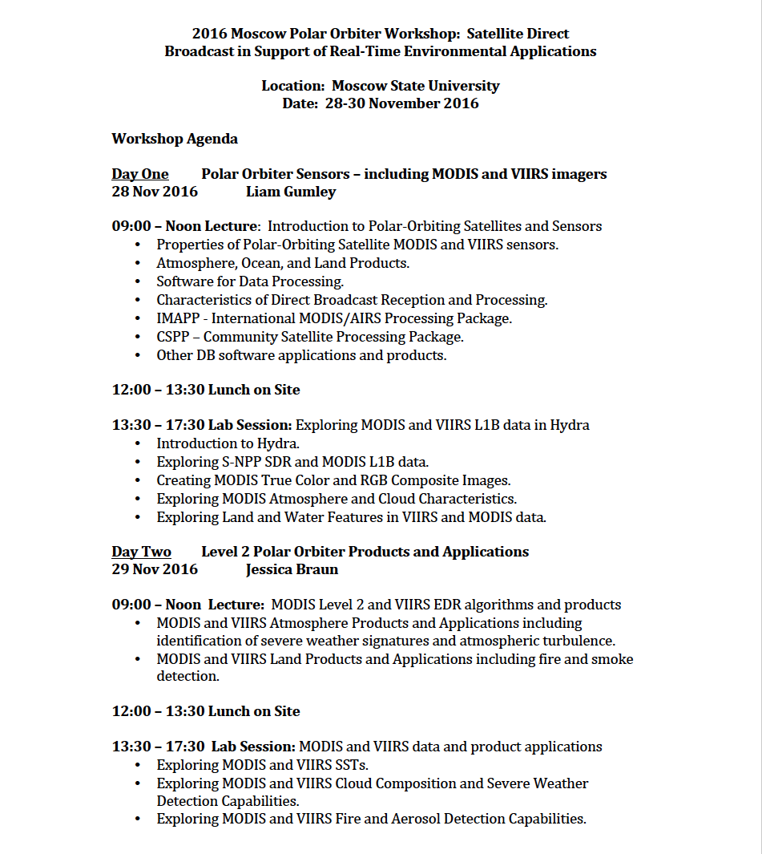

Sample Workshop Agenda

Slide 8
HYDRA2 Analysis Toolkit
Free software tool used during workshops.
  Developed at SSEC by Tom Rink.
Create interactive displays of L1B and L2 products from:
  Multispectral imagers (VIIRS, MODIS)
  High spectral sounders (CrIS, AIRS, IASI)
  Microwave sounders (ATMS, AMSU)
Data can be collocated, combined, and analyzed using spectral diagrams, cross sections, scatter plots, multi-band combinations, and color enhancements.

Slide 9
HYDRA2 Examples

Slide 10
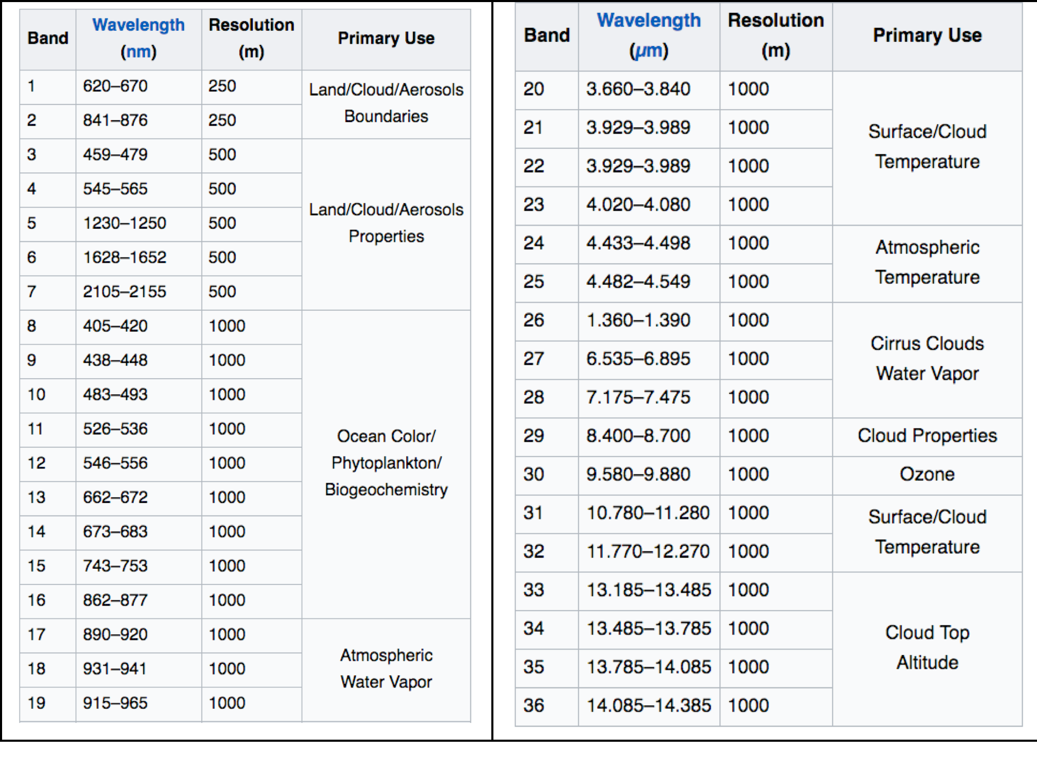
MODIS Band Characteristics

Slide 11
VIIRS Band Characteristics

Slide 12
Why so many bands?

Slide 13
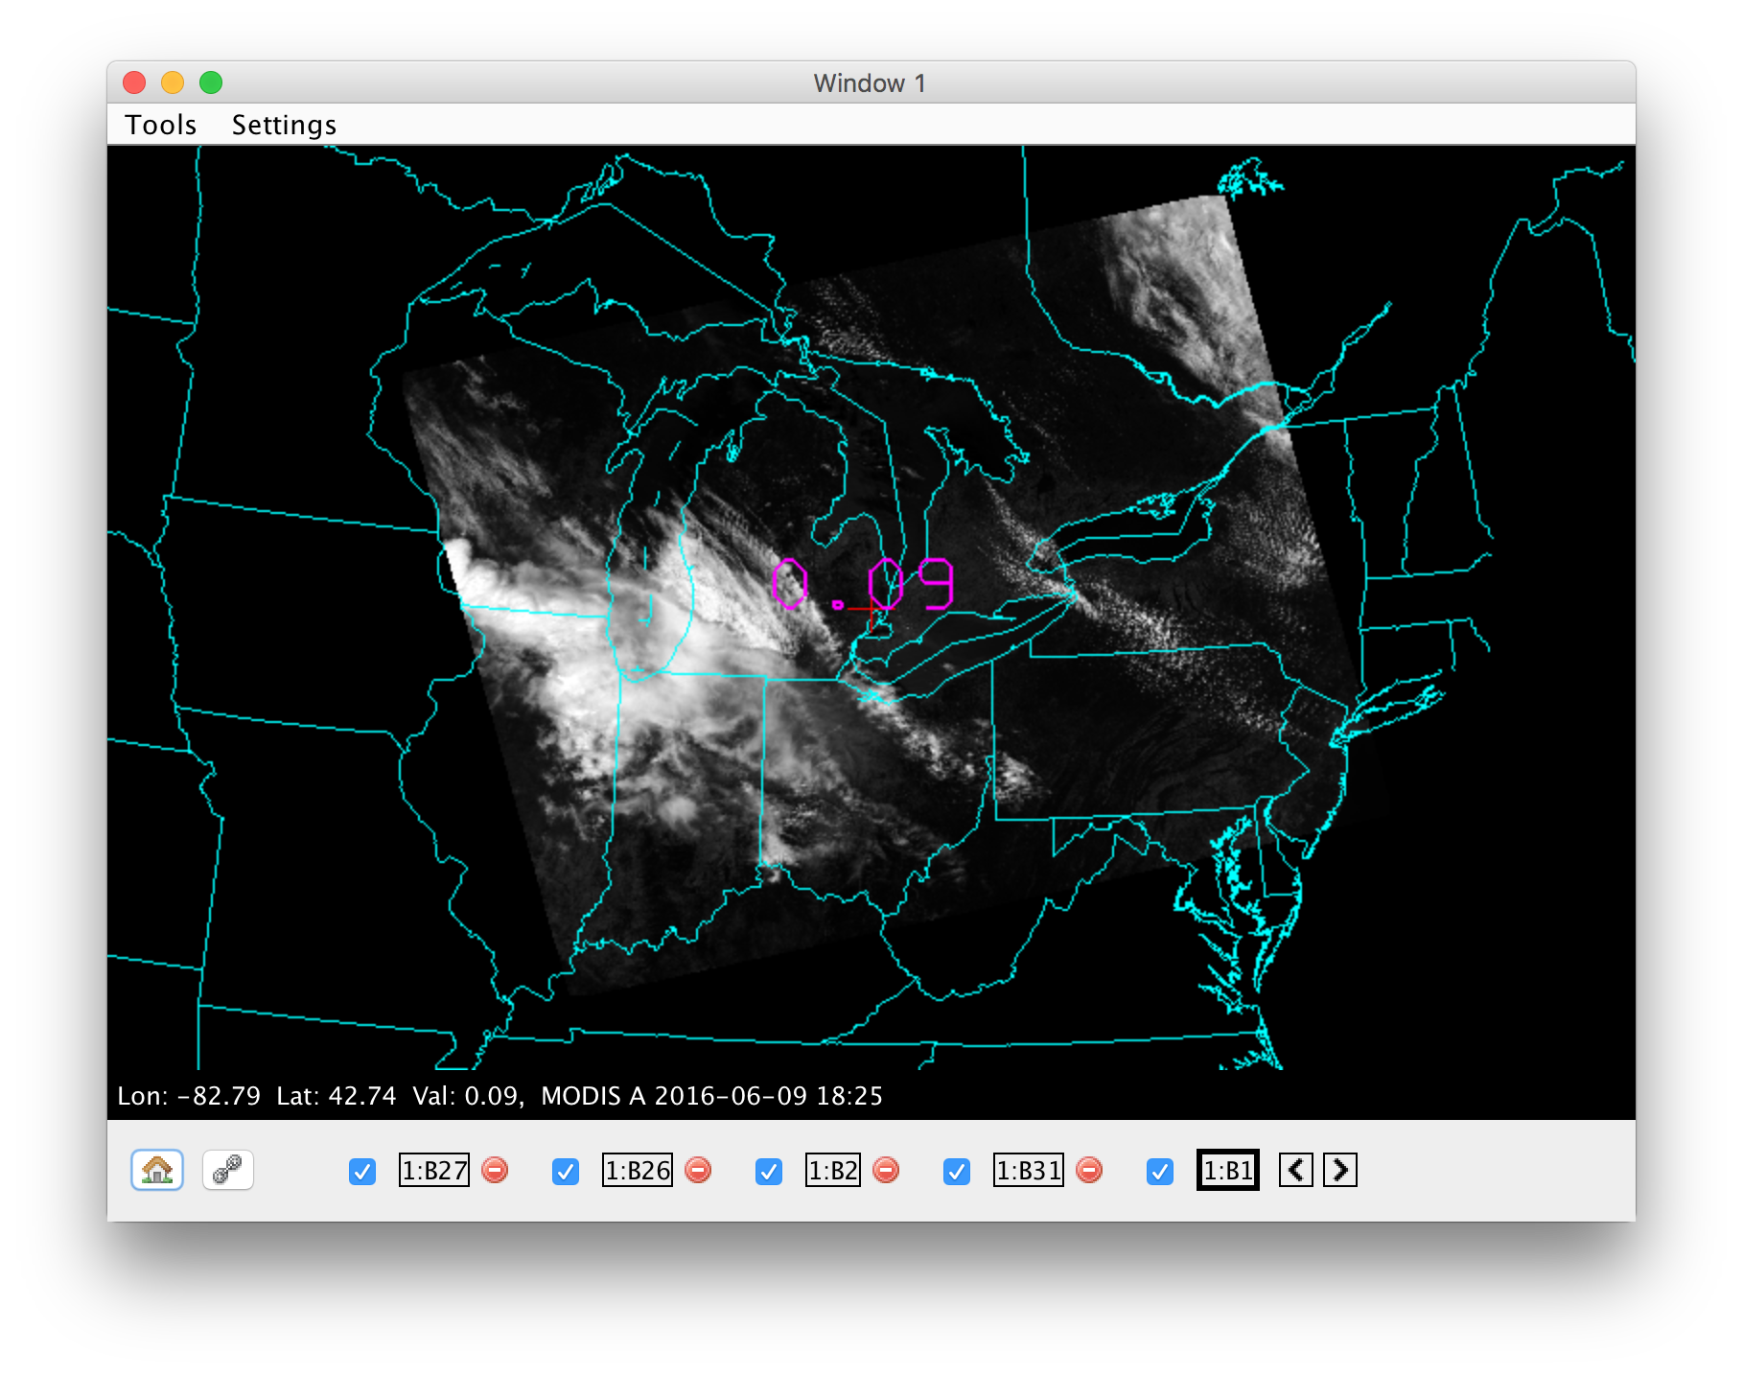
MODIS Band 1 (0.65μm)

Slide 14
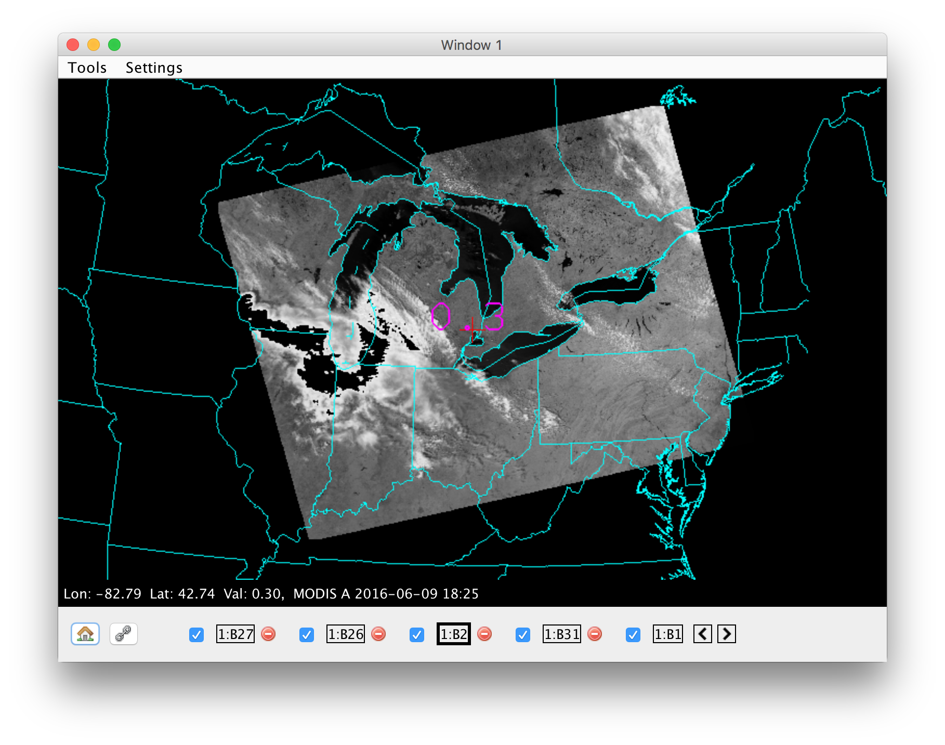
Vegetation
MODIS Band 2 (0.855μm)

Slide 15
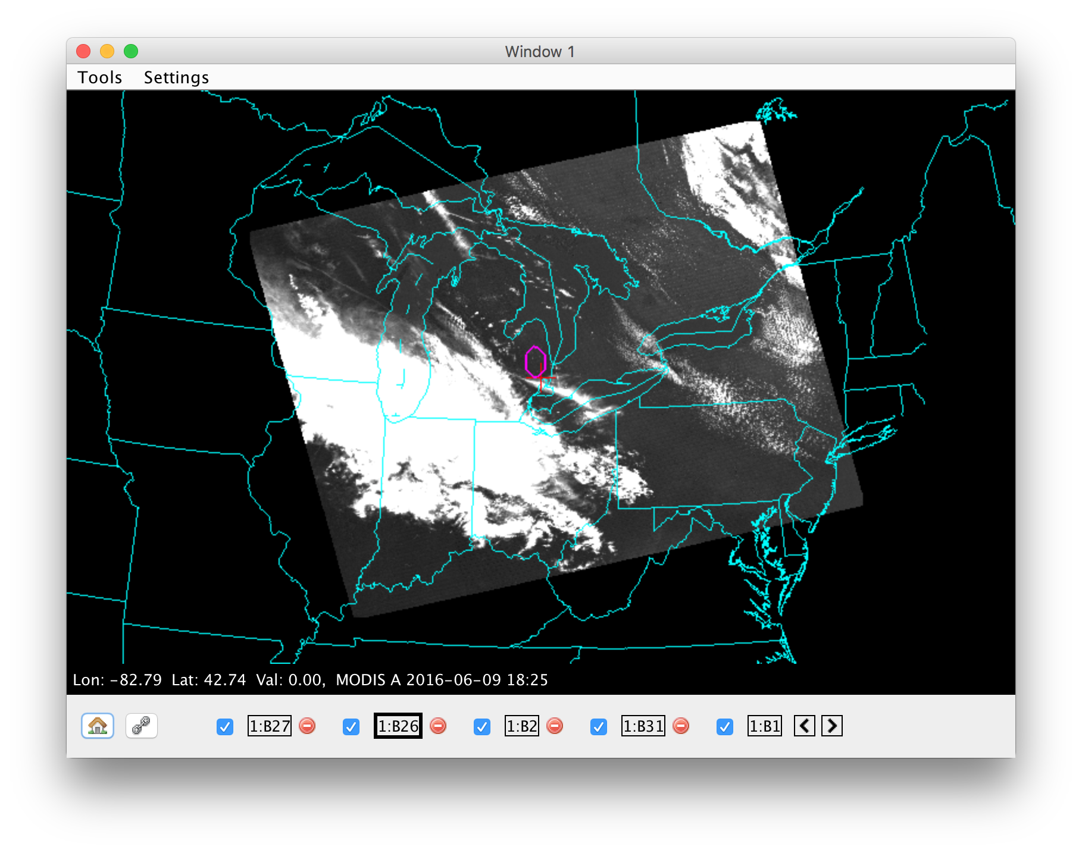
Cirrus Band
MODIS Band 26 (1.375 μm)
Notes:
Strong water vapor absorption, good daytime sensitivity to high cirrus clouds

Slide 16
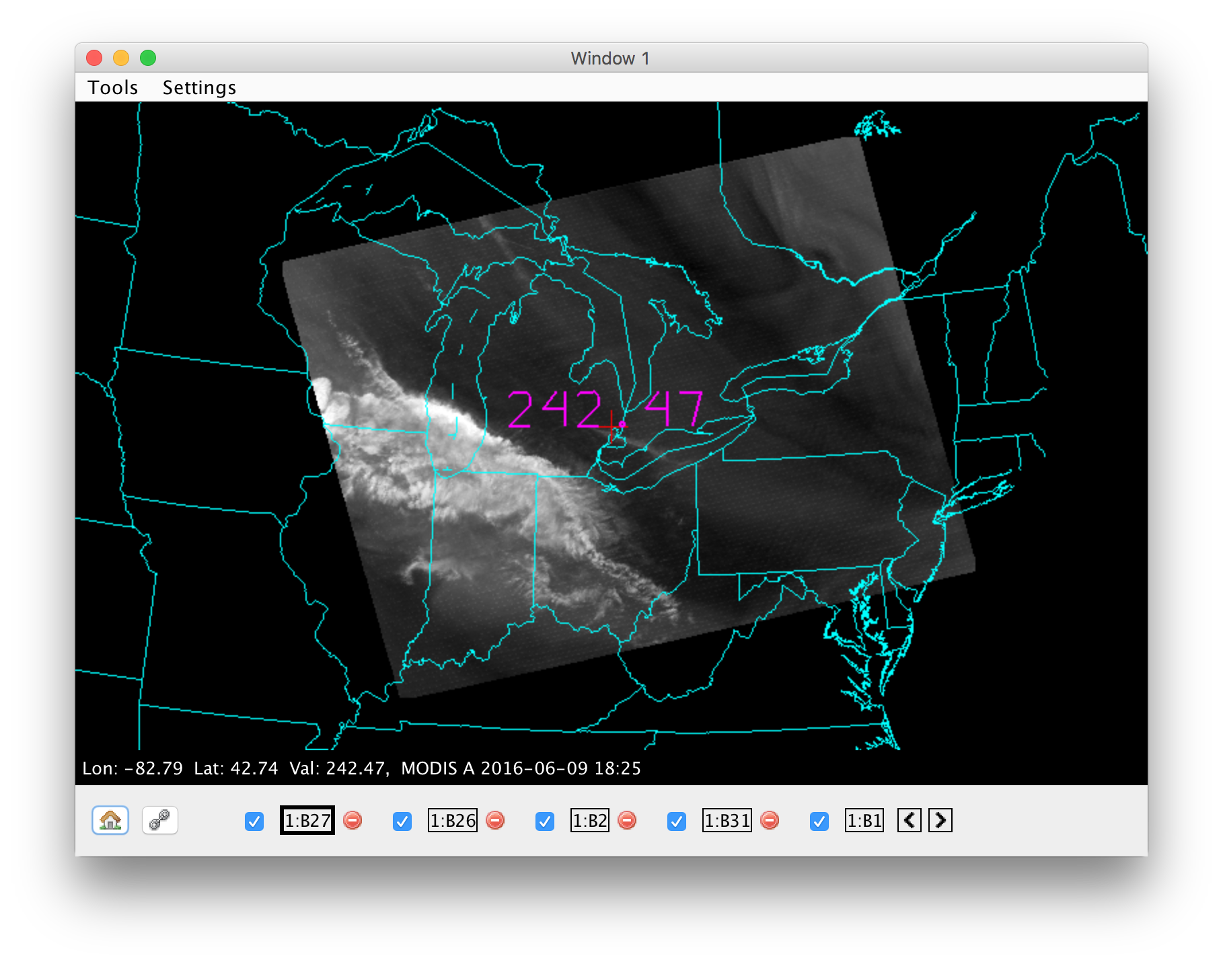
Water Vapor
MODIS Band 27 (6.784 μm)

Slide 17
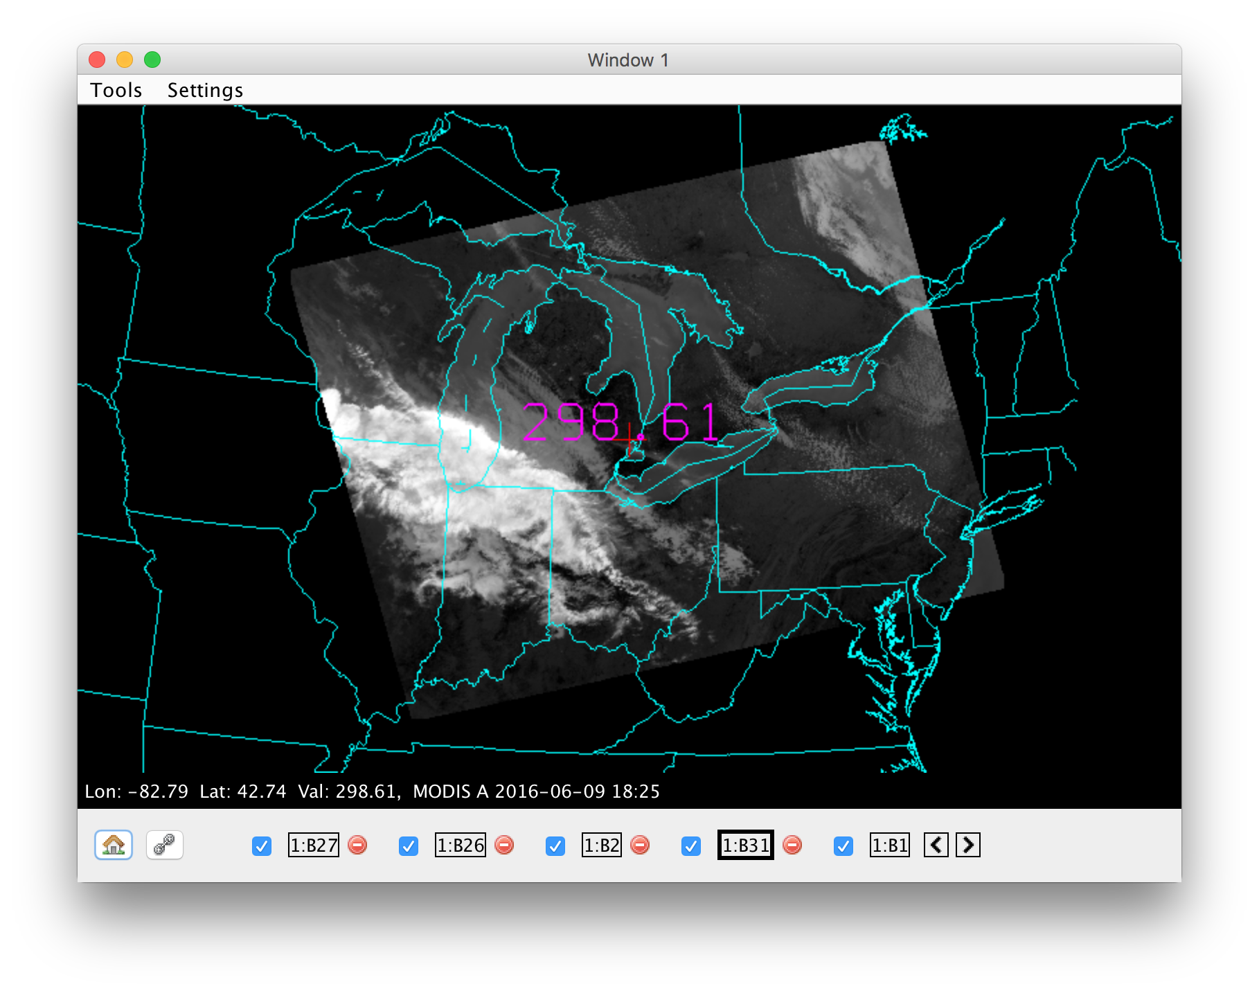
Longwave Infrared
MODIS Band 31 (11.0 μm)
Notes:
We can pick out features between all bands that are consistent, different, varying.

Slide 18
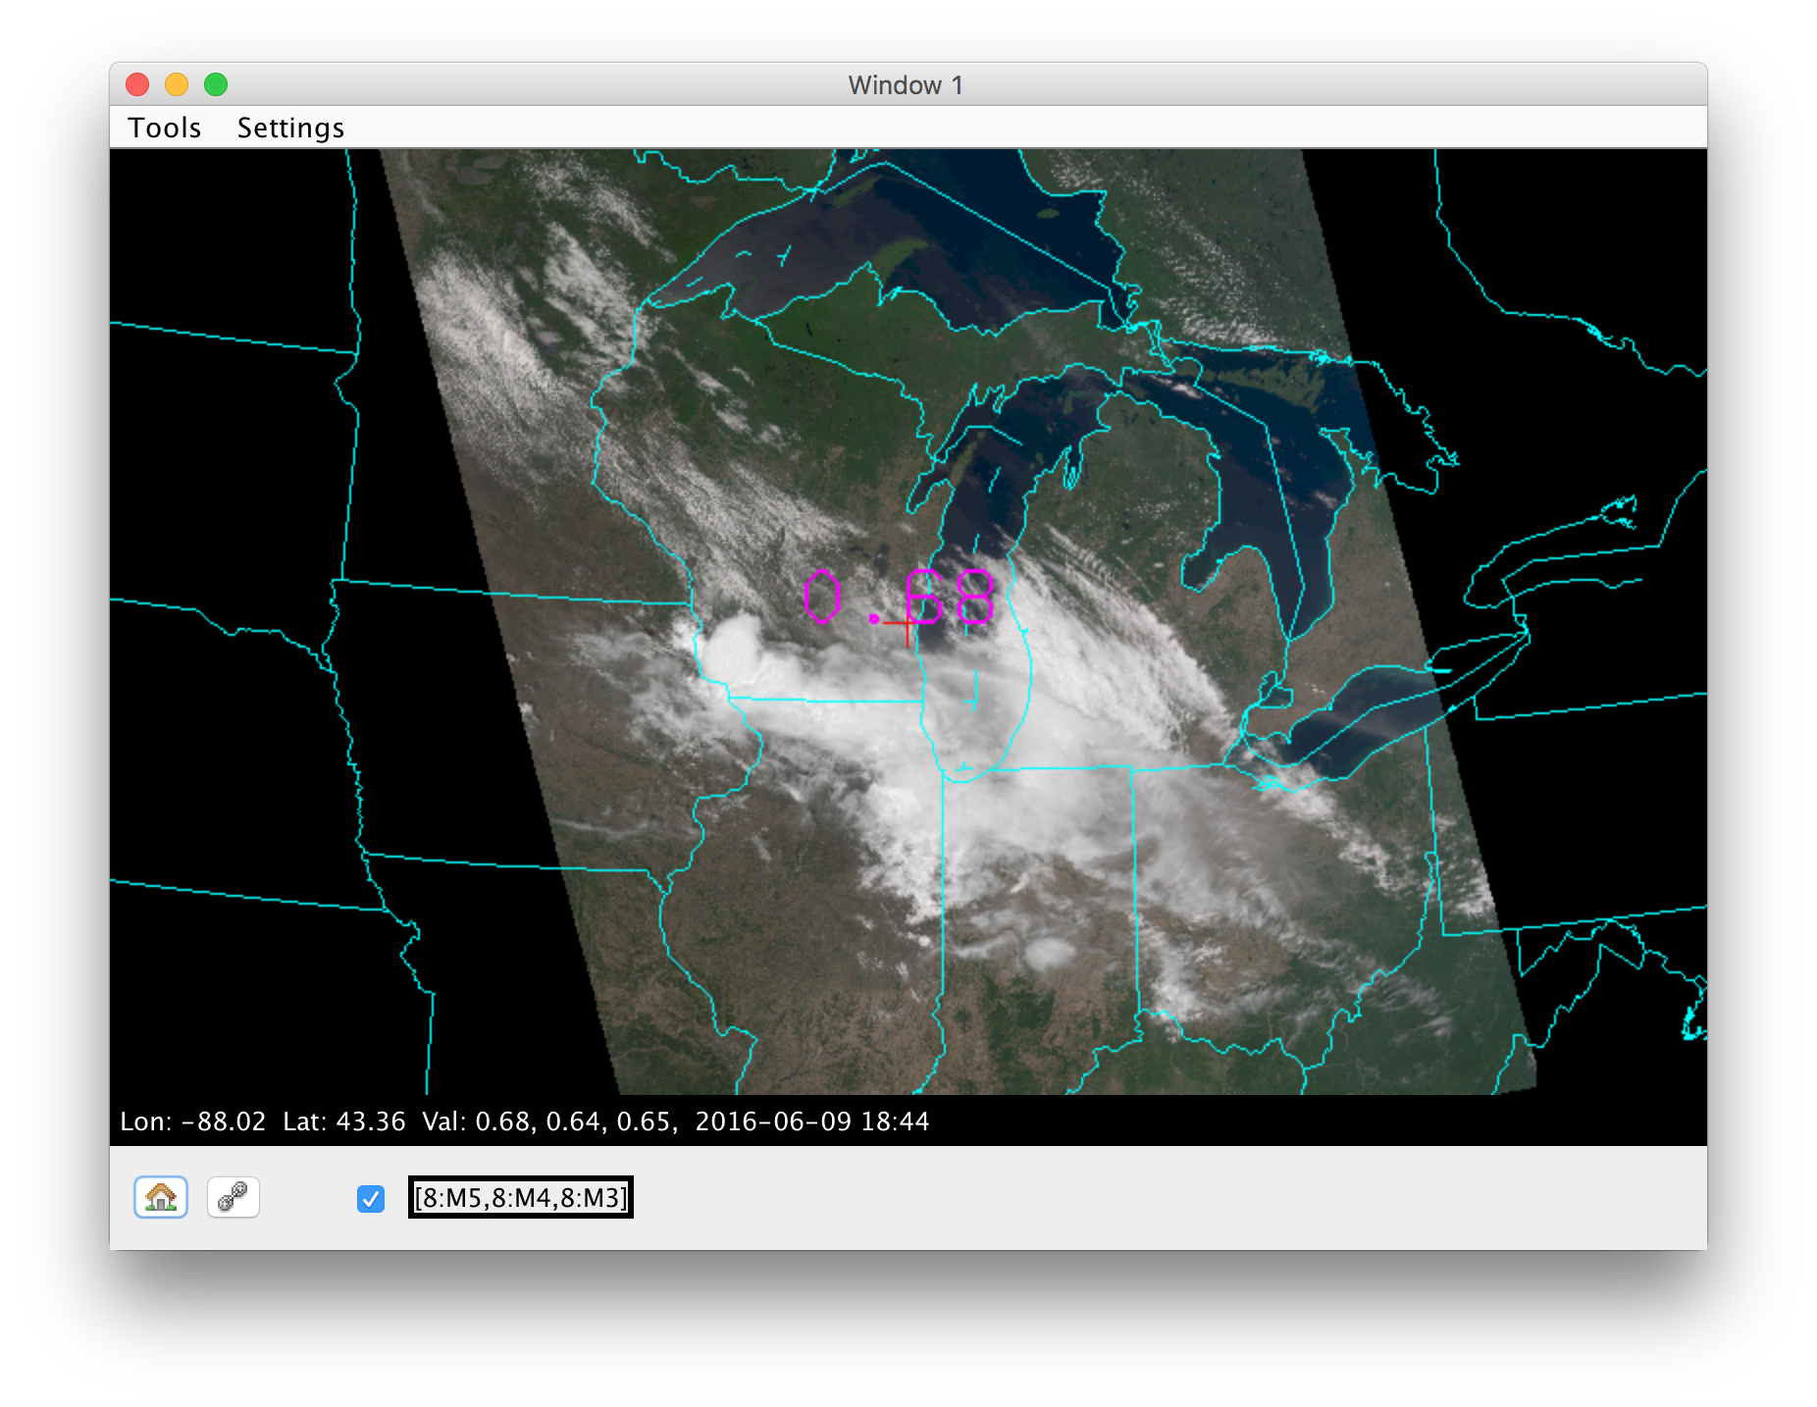
True Color RGB
Notes:
Now that we understand the bands, we can apply further knowledge to create RGB image

Slide 19
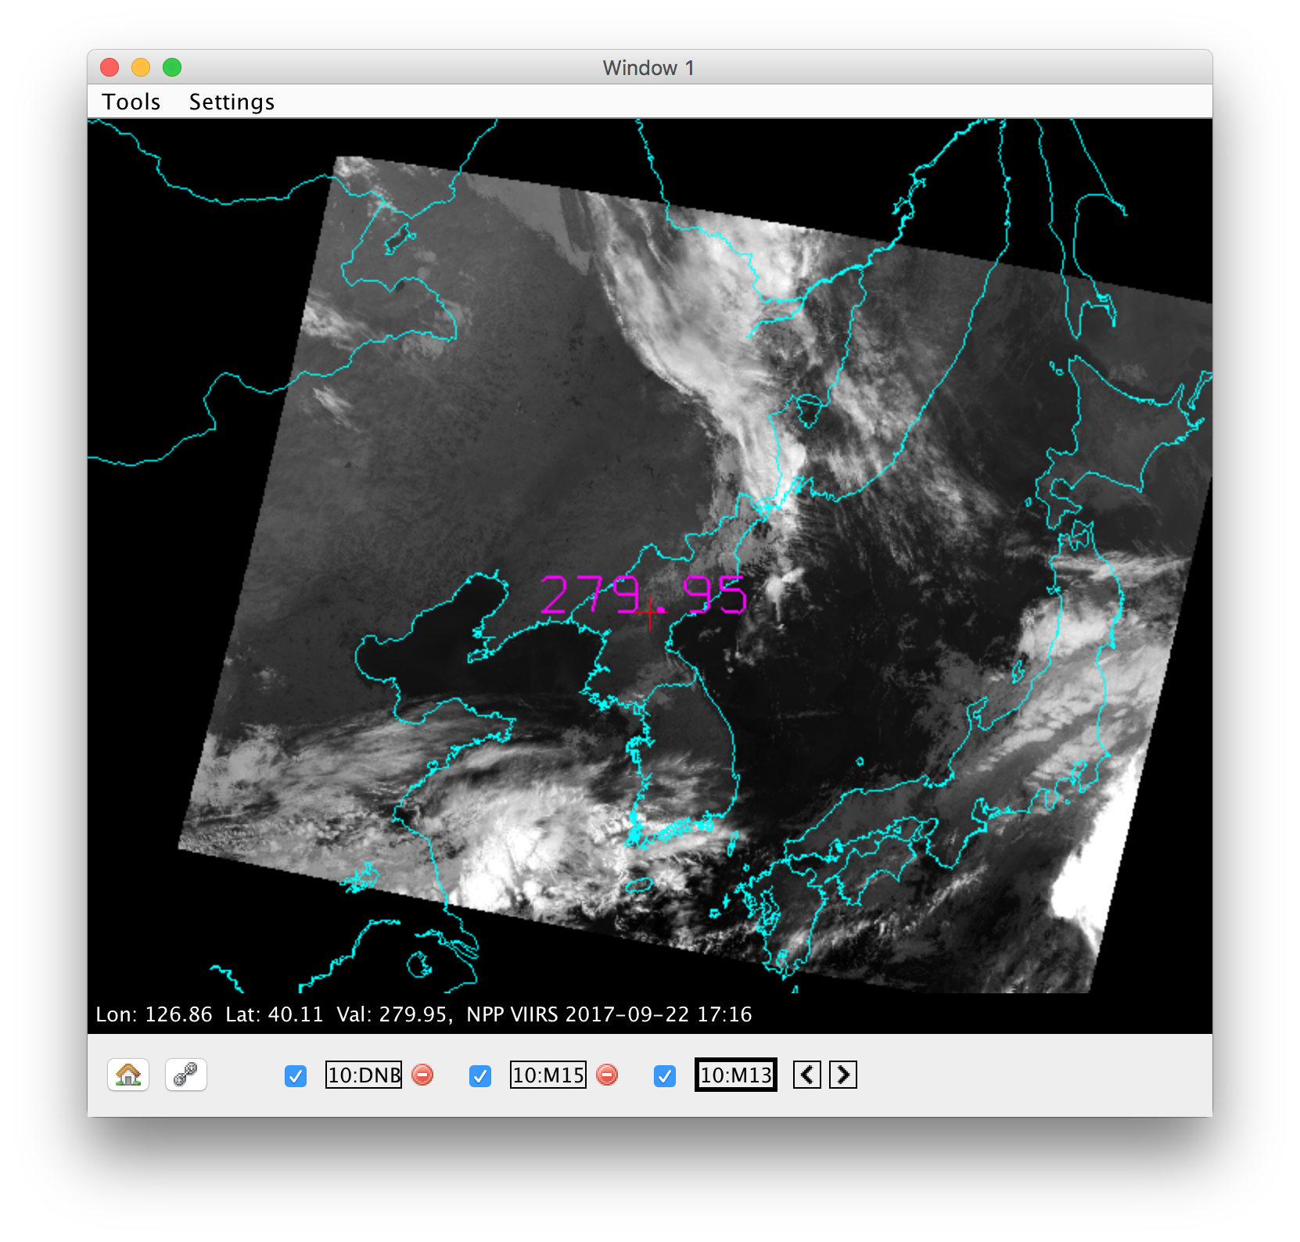
Shortwave Infrared
VIIRS Band M13 – 4.05μm
Notes:
Additional solar reflected component

Slide 20
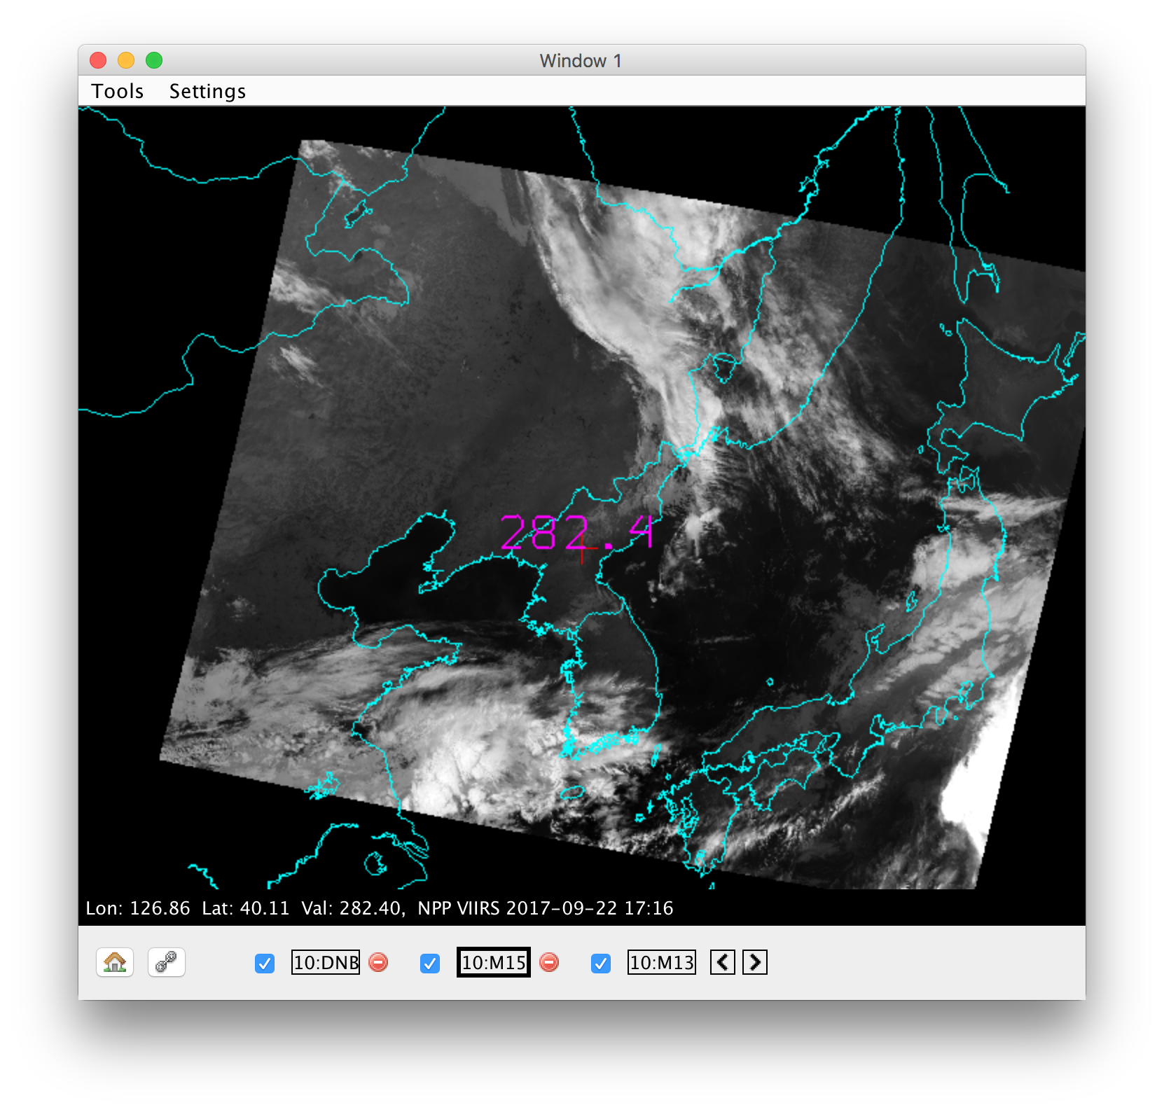
Longwave Infrared
VIIRS Band M15 – 10.7 μm

Slide 21
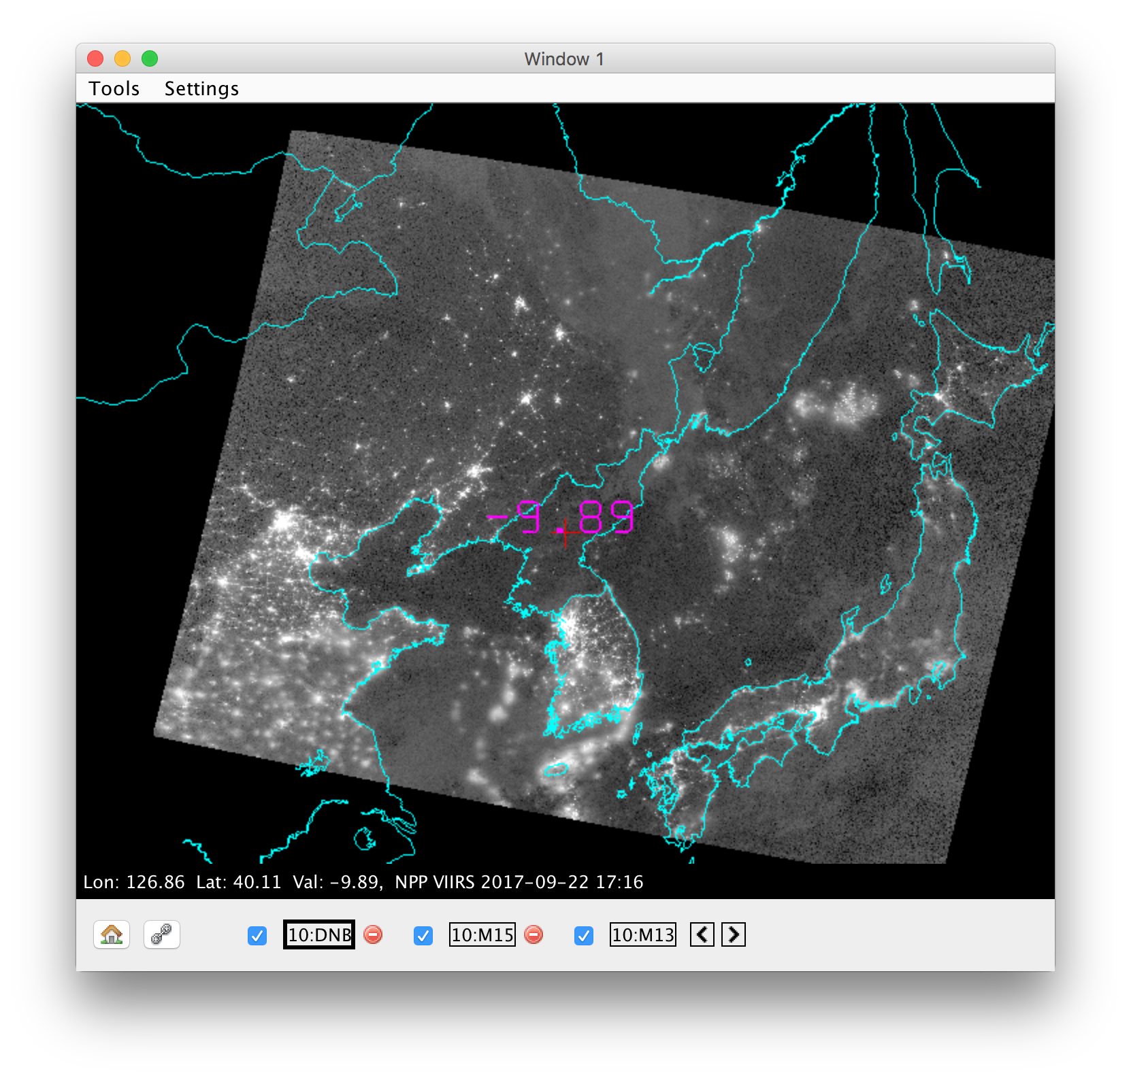
DNB
VIIRS DNB– 0.7 μm
Notes:
We’ve just added another piece to the puzzle - another band for students to analyze and compare differneces. In case of DNB, can compare either daytime or nighttime.

Slide 22
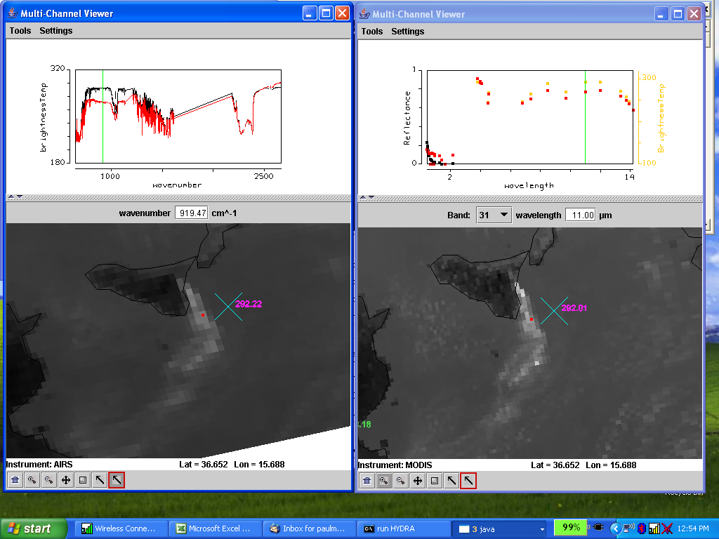
HYDRA 2 Analysis Toolkit
Colocated AIRS (left) & MODIS (right) spectra in & out of Etna ash

Slide 23
Lab examples

Slide 24
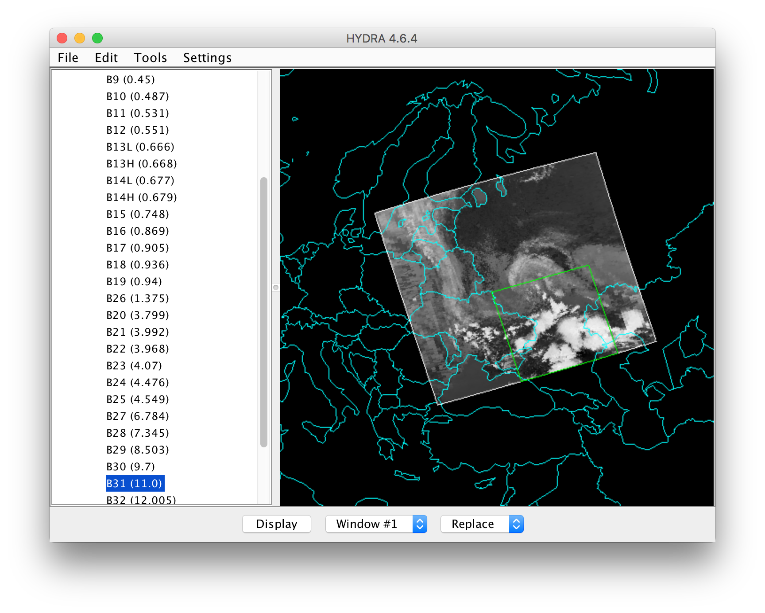
Comparison of Band Transects
Notes:
Over Eastern Europe.

Slide 25
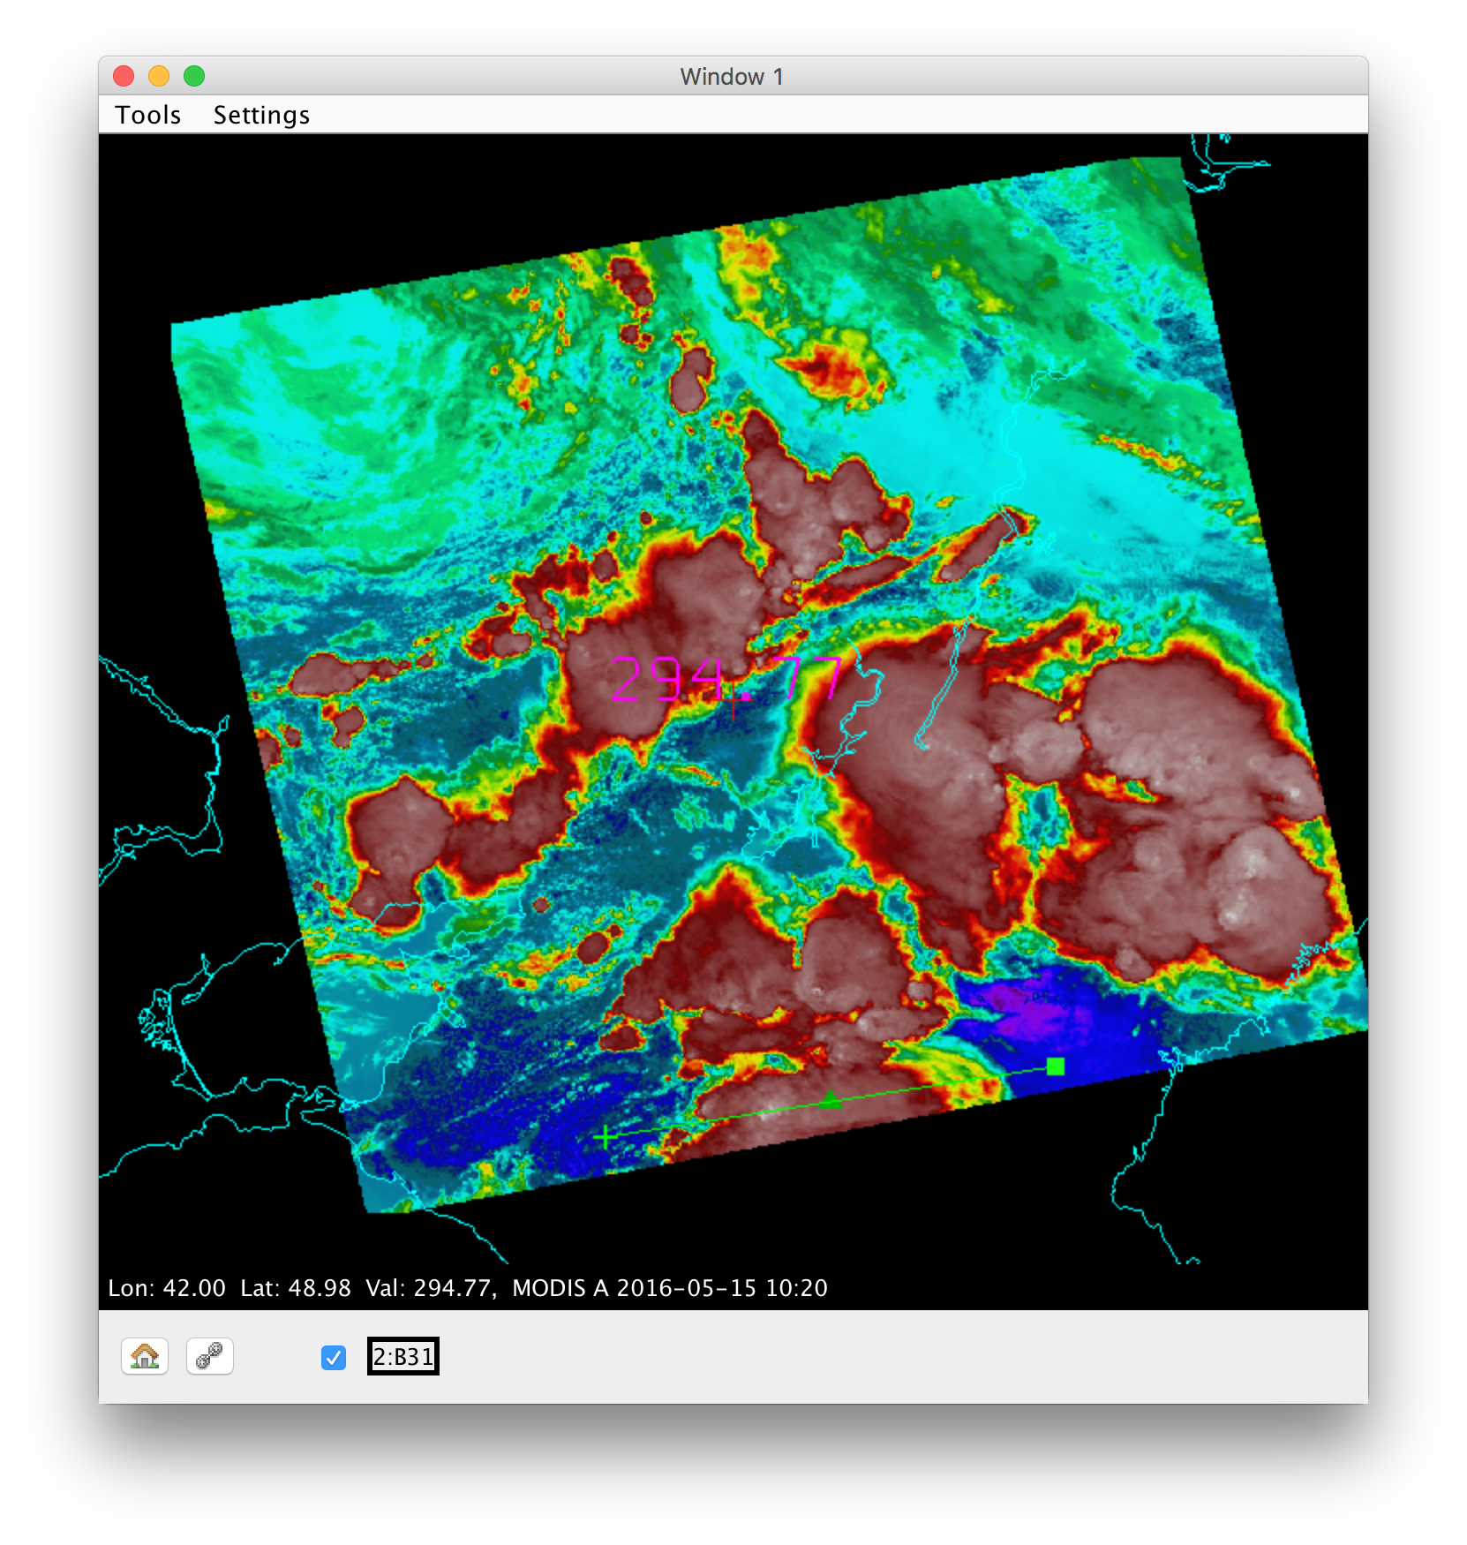
MODIS Band 31 – 11.0 μm

Slide 26
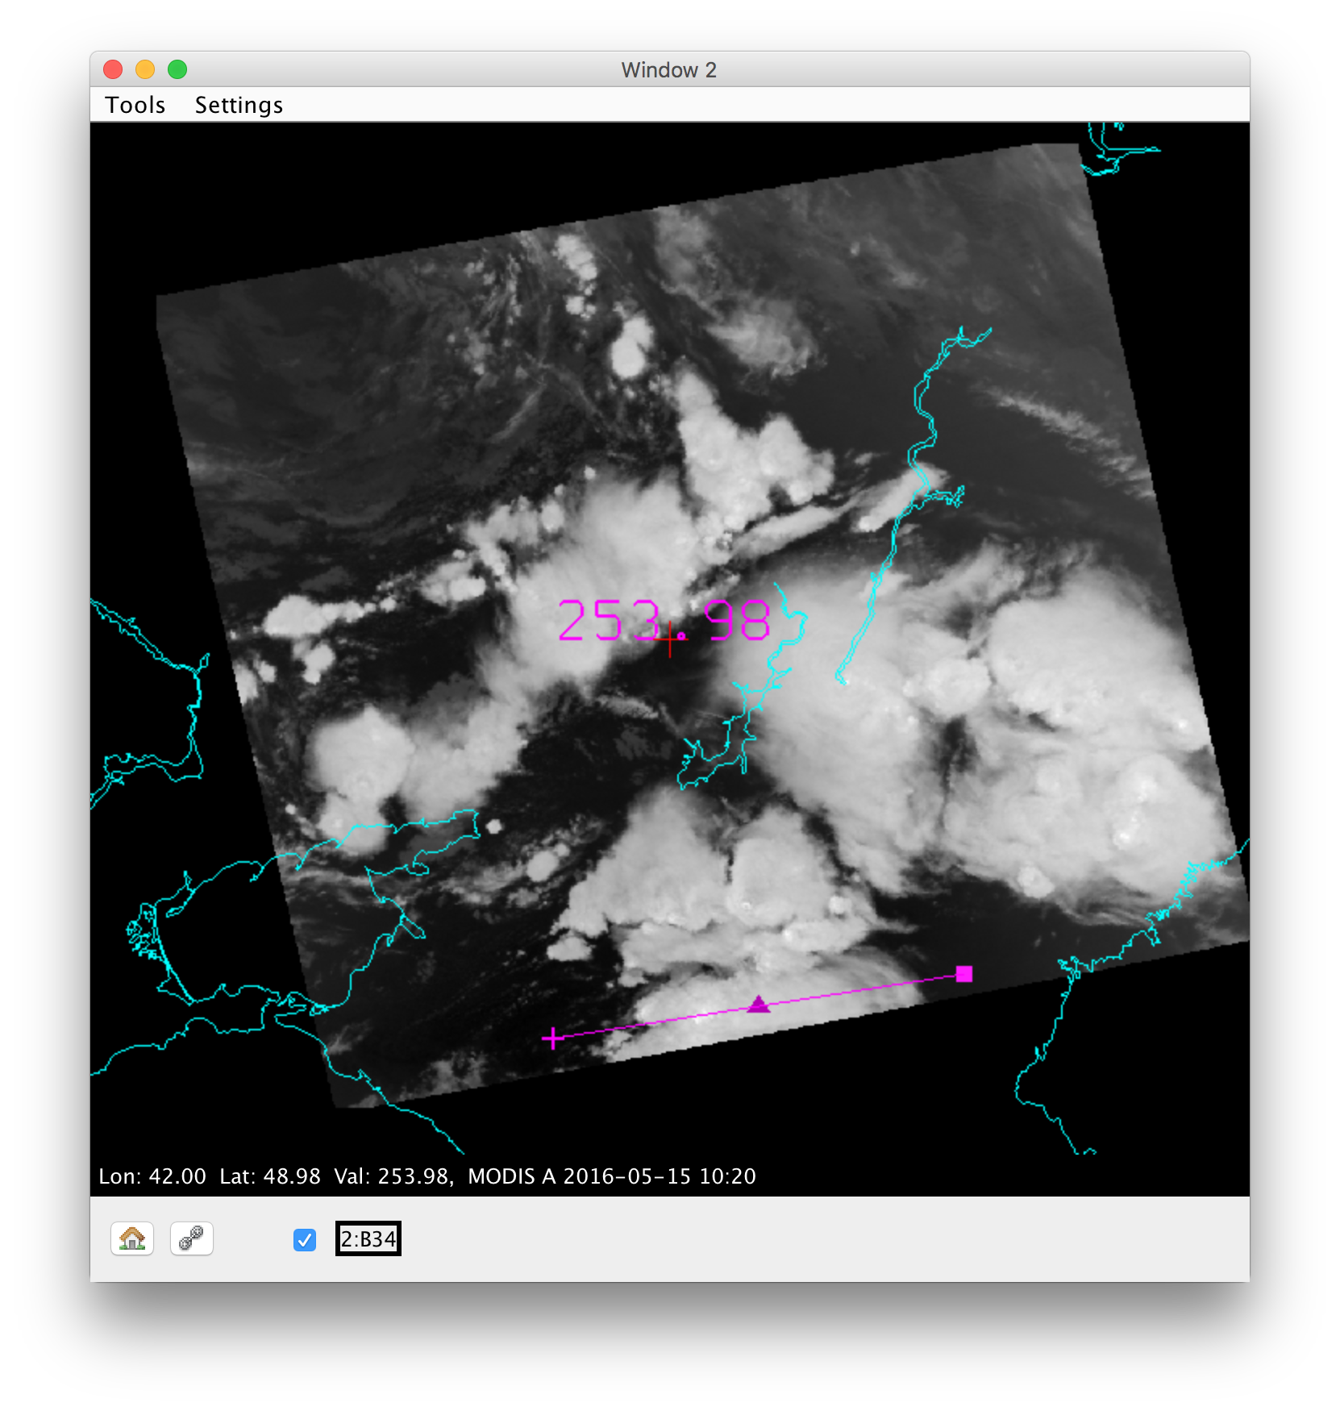
MODIS Band 34 – 13.6 μm

Slide 27
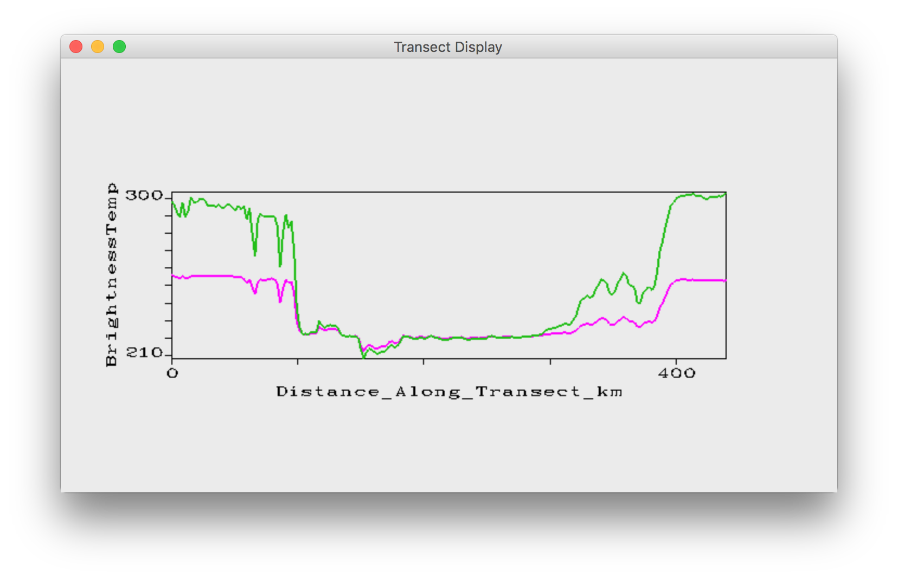
Green – Band 31 (11.0 μm) (Left image)
Magenta – Band 34 (13.7μm) (Right image)
27
27

Slide 28
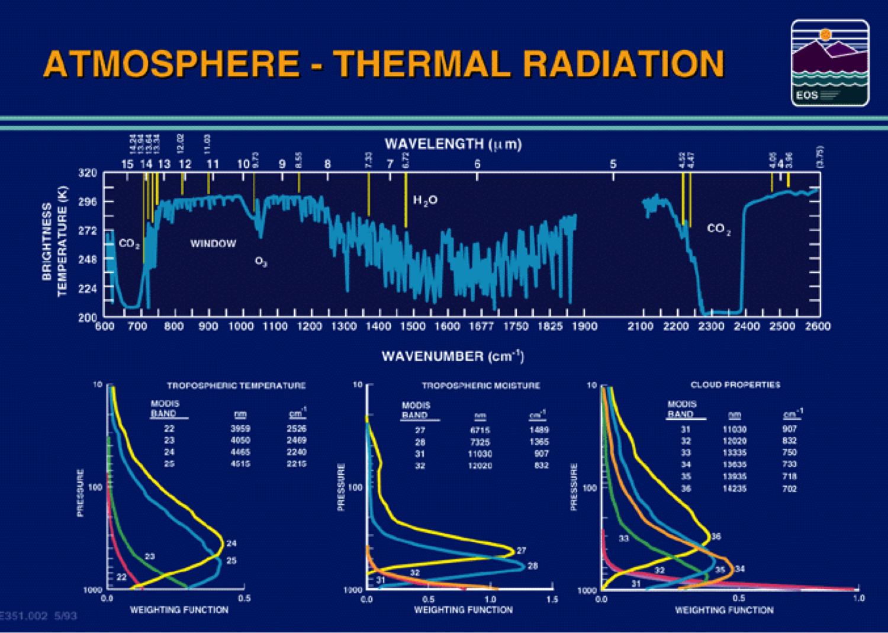
Notes:
Change of total transmittance with respect to pressure

Slide 29
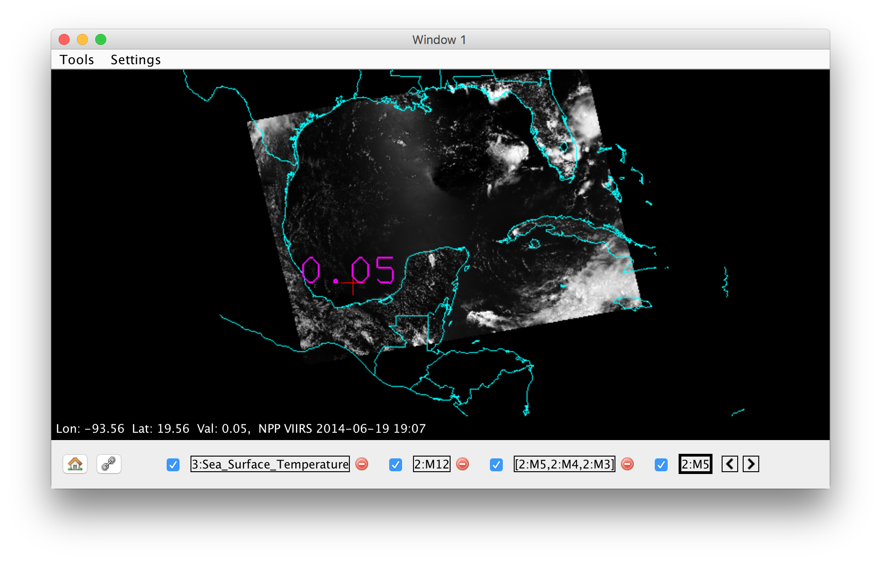
VIIRS SST Analysis
VIIRS M5 – 0.67μm

Slide 30
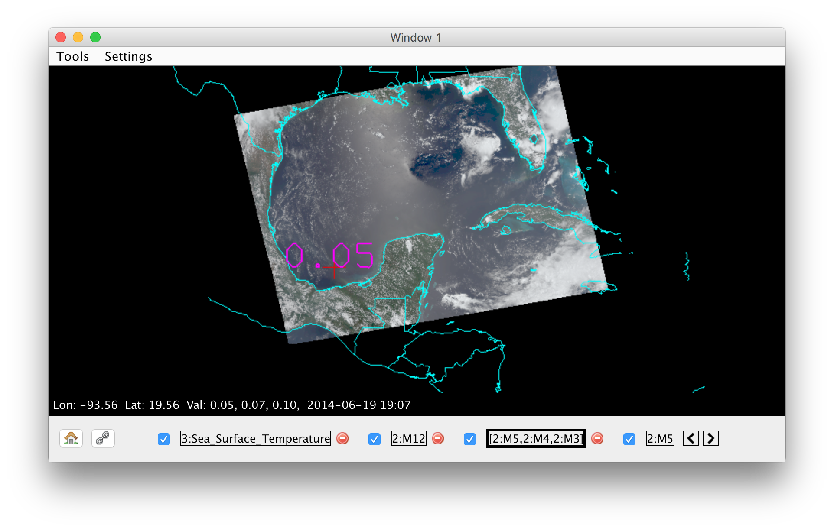
VIIRS SST Analysis
VIIRS True Color RGB – M5:M4:M3

Slide 31
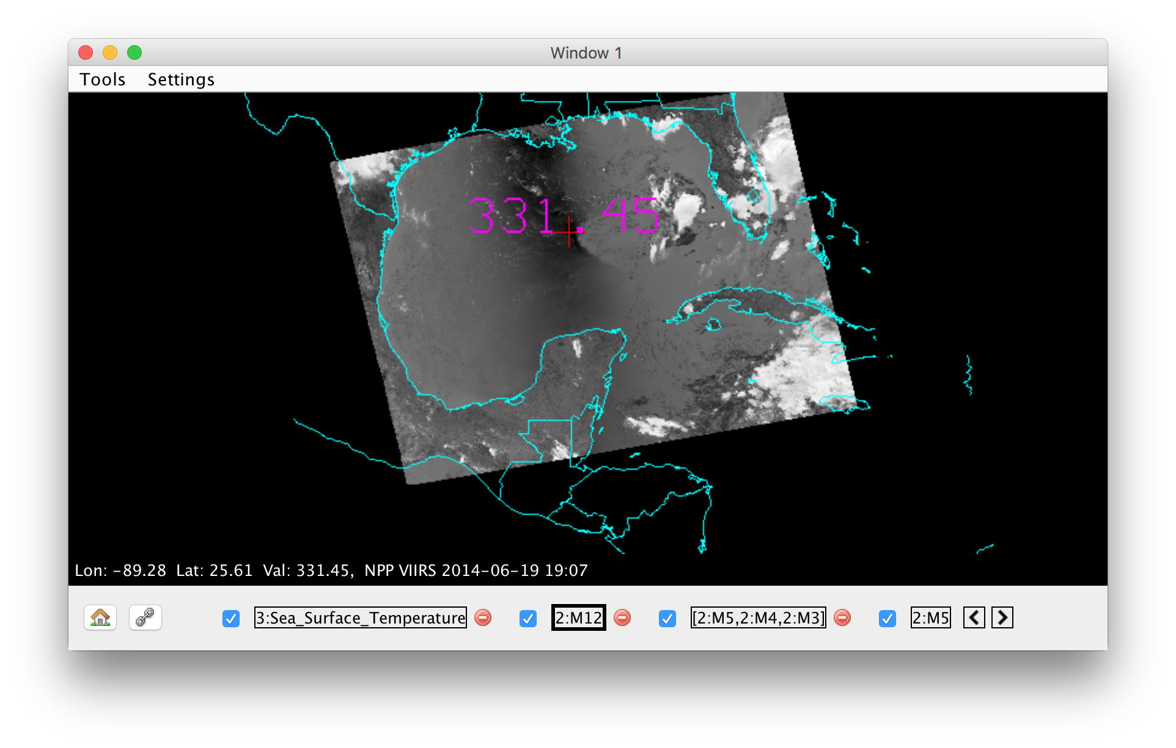
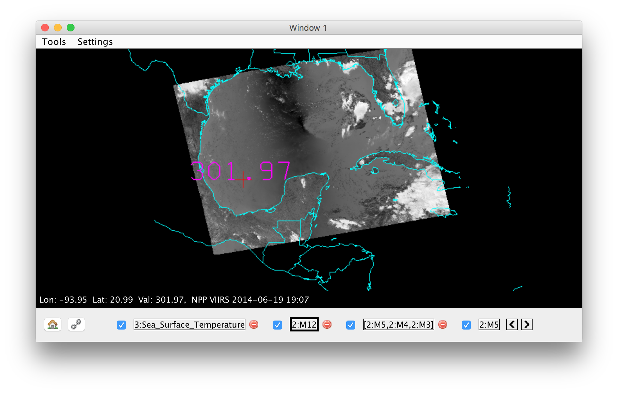
VIIRS SST Analysis
VIIRS M12 – 3.7 μm
VIIRS M12 – 3.7 μm

Slide 32
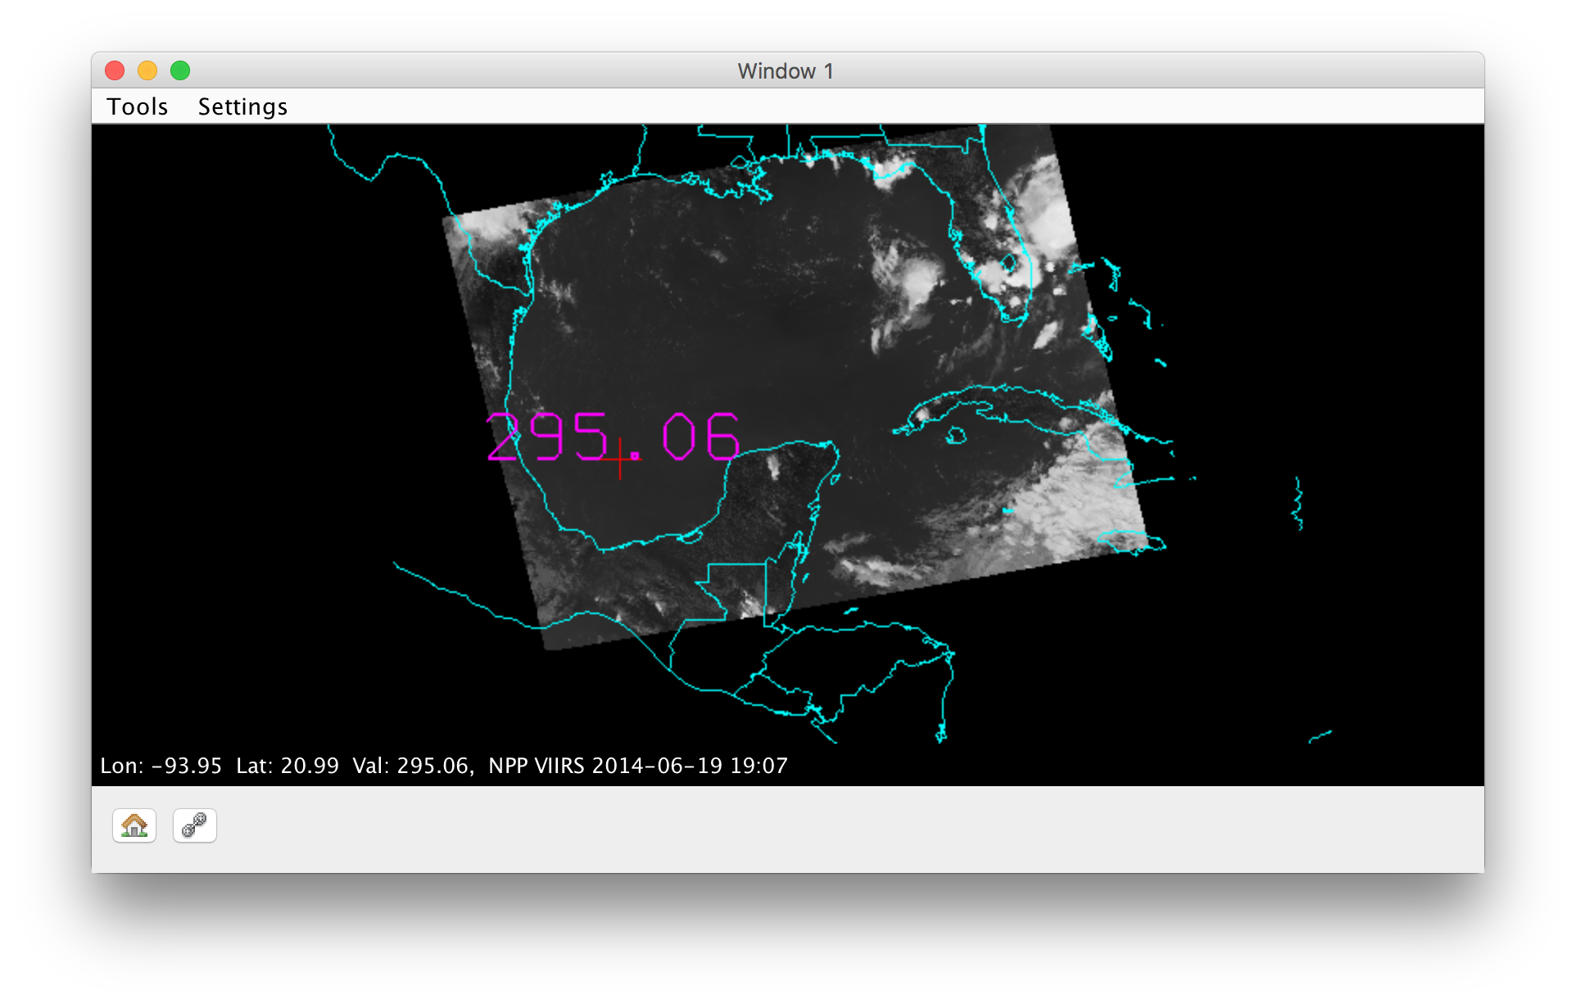
VIIRS SST Analysis
VIIRS M15 – 11.0 μm
VIIRS M12 – 3.7 μm

Slide 33
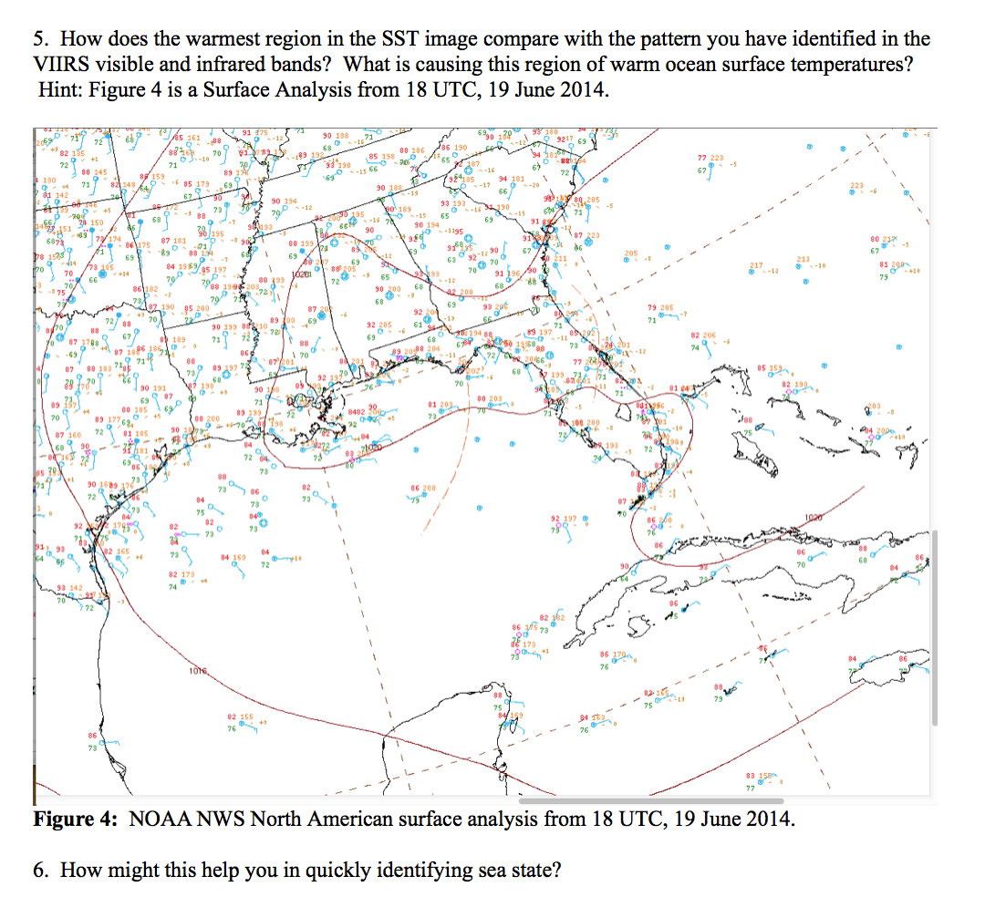
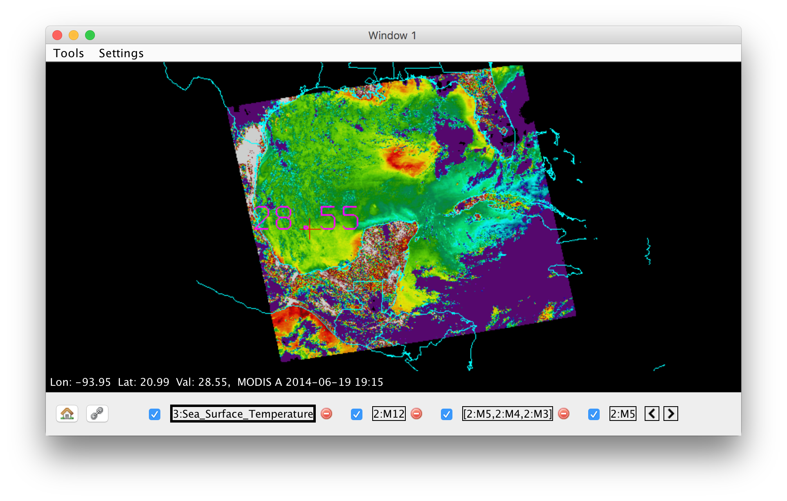
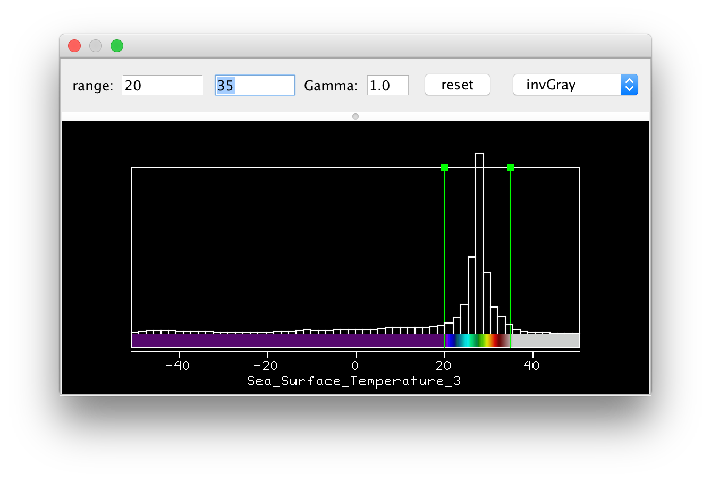
MODIS L2 SST Product

Slide 34
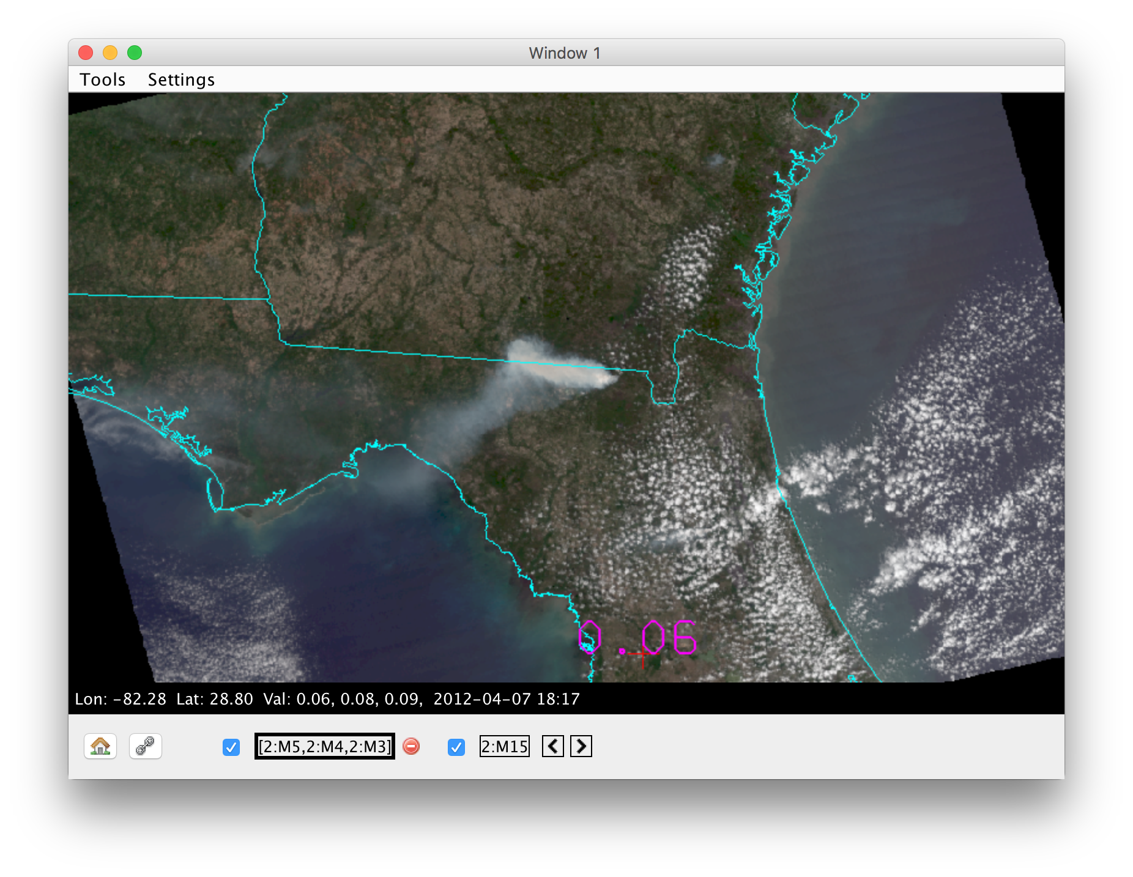
Fire Detection Algorithm

Slide 35
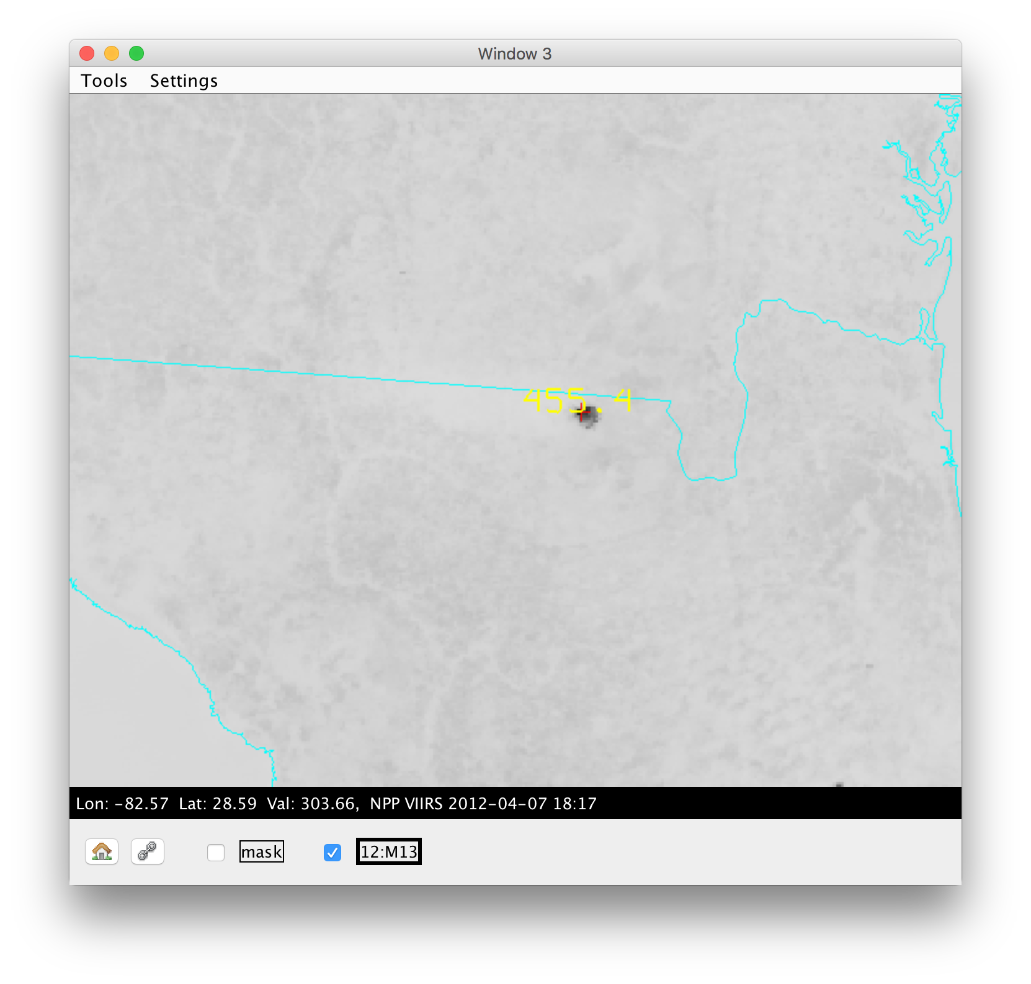
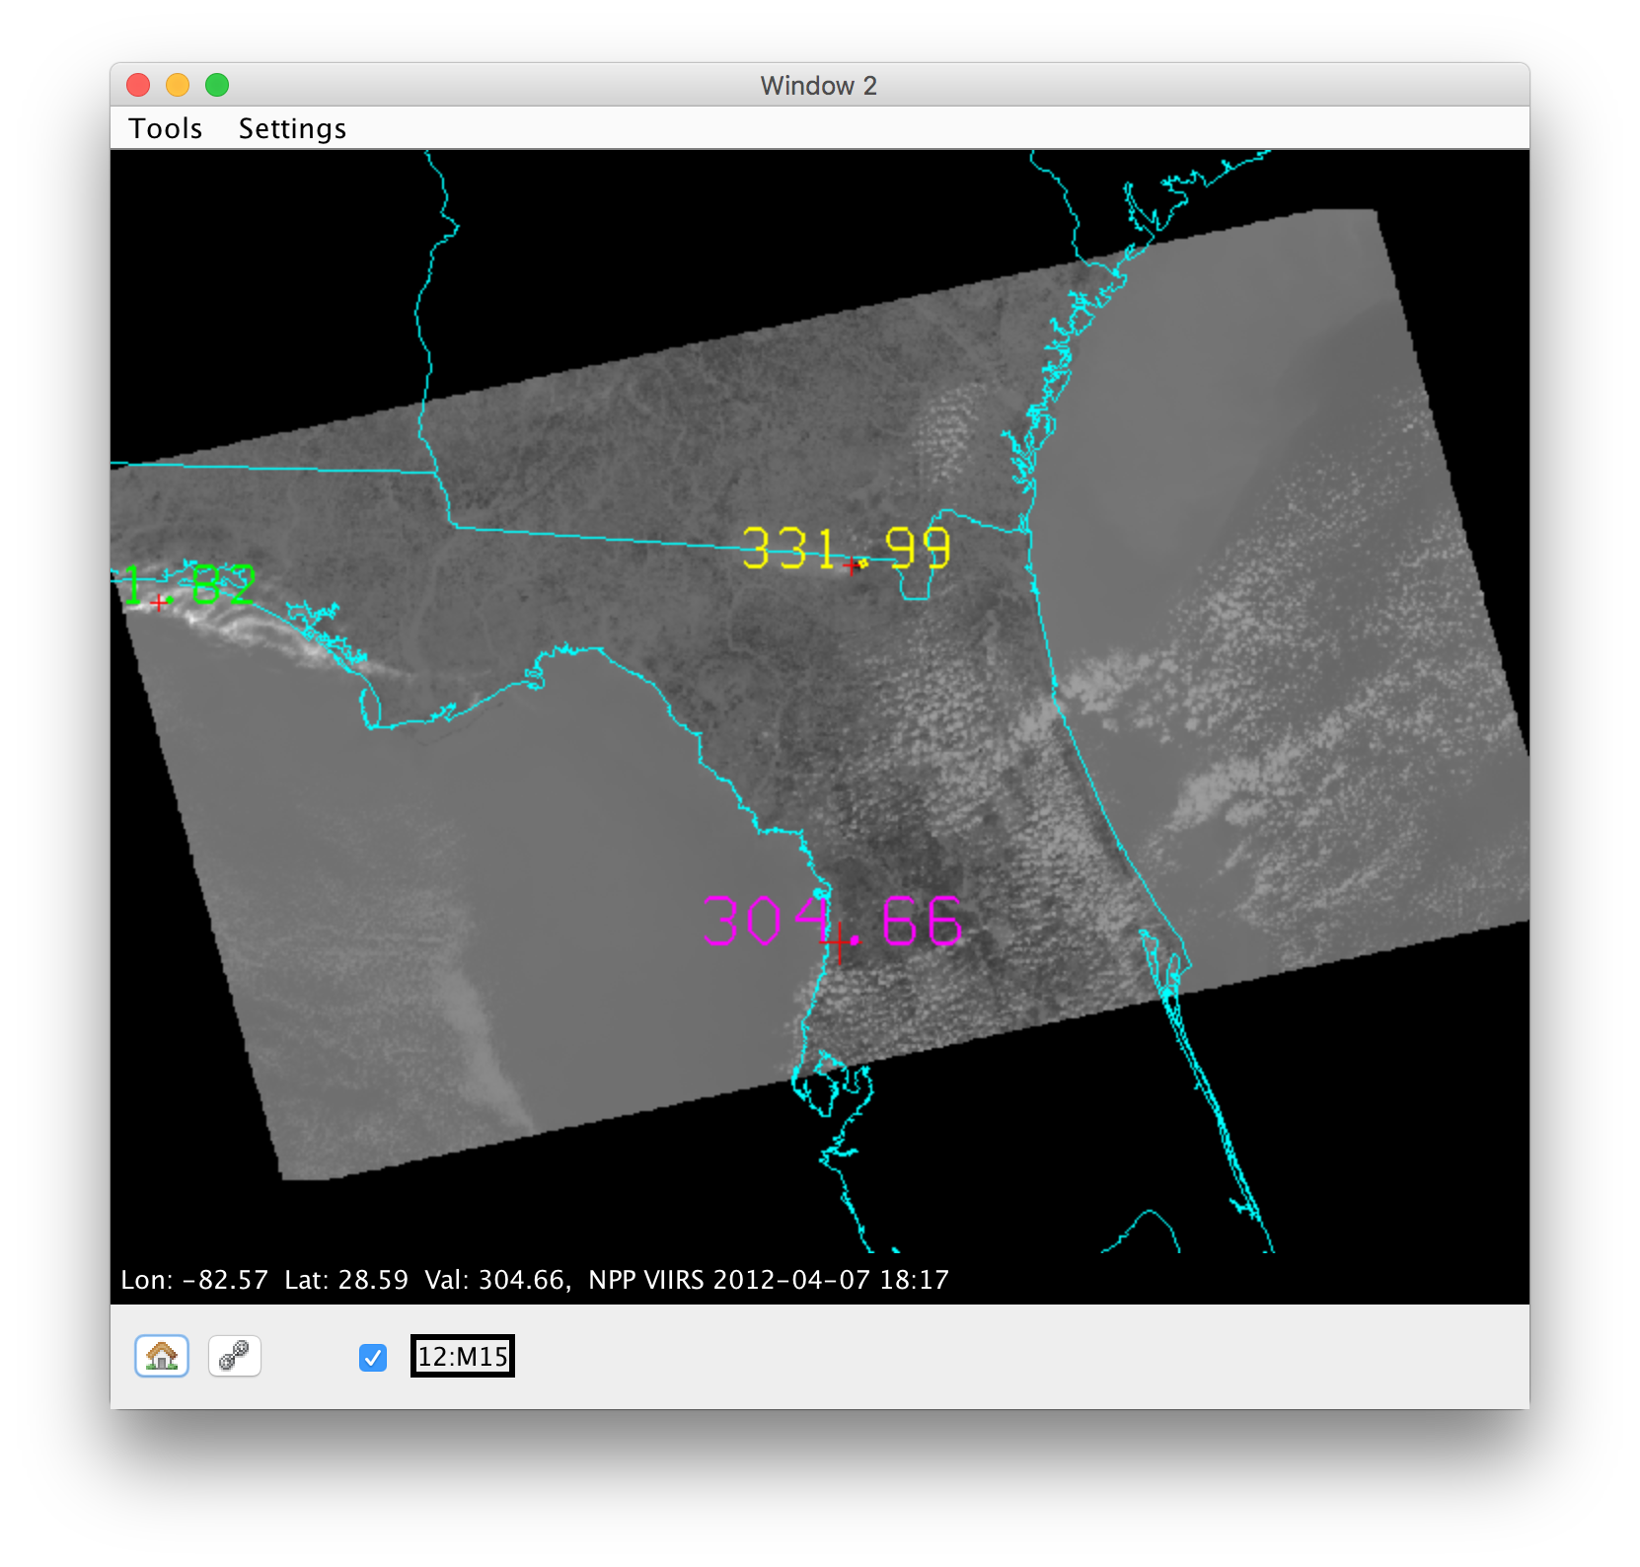
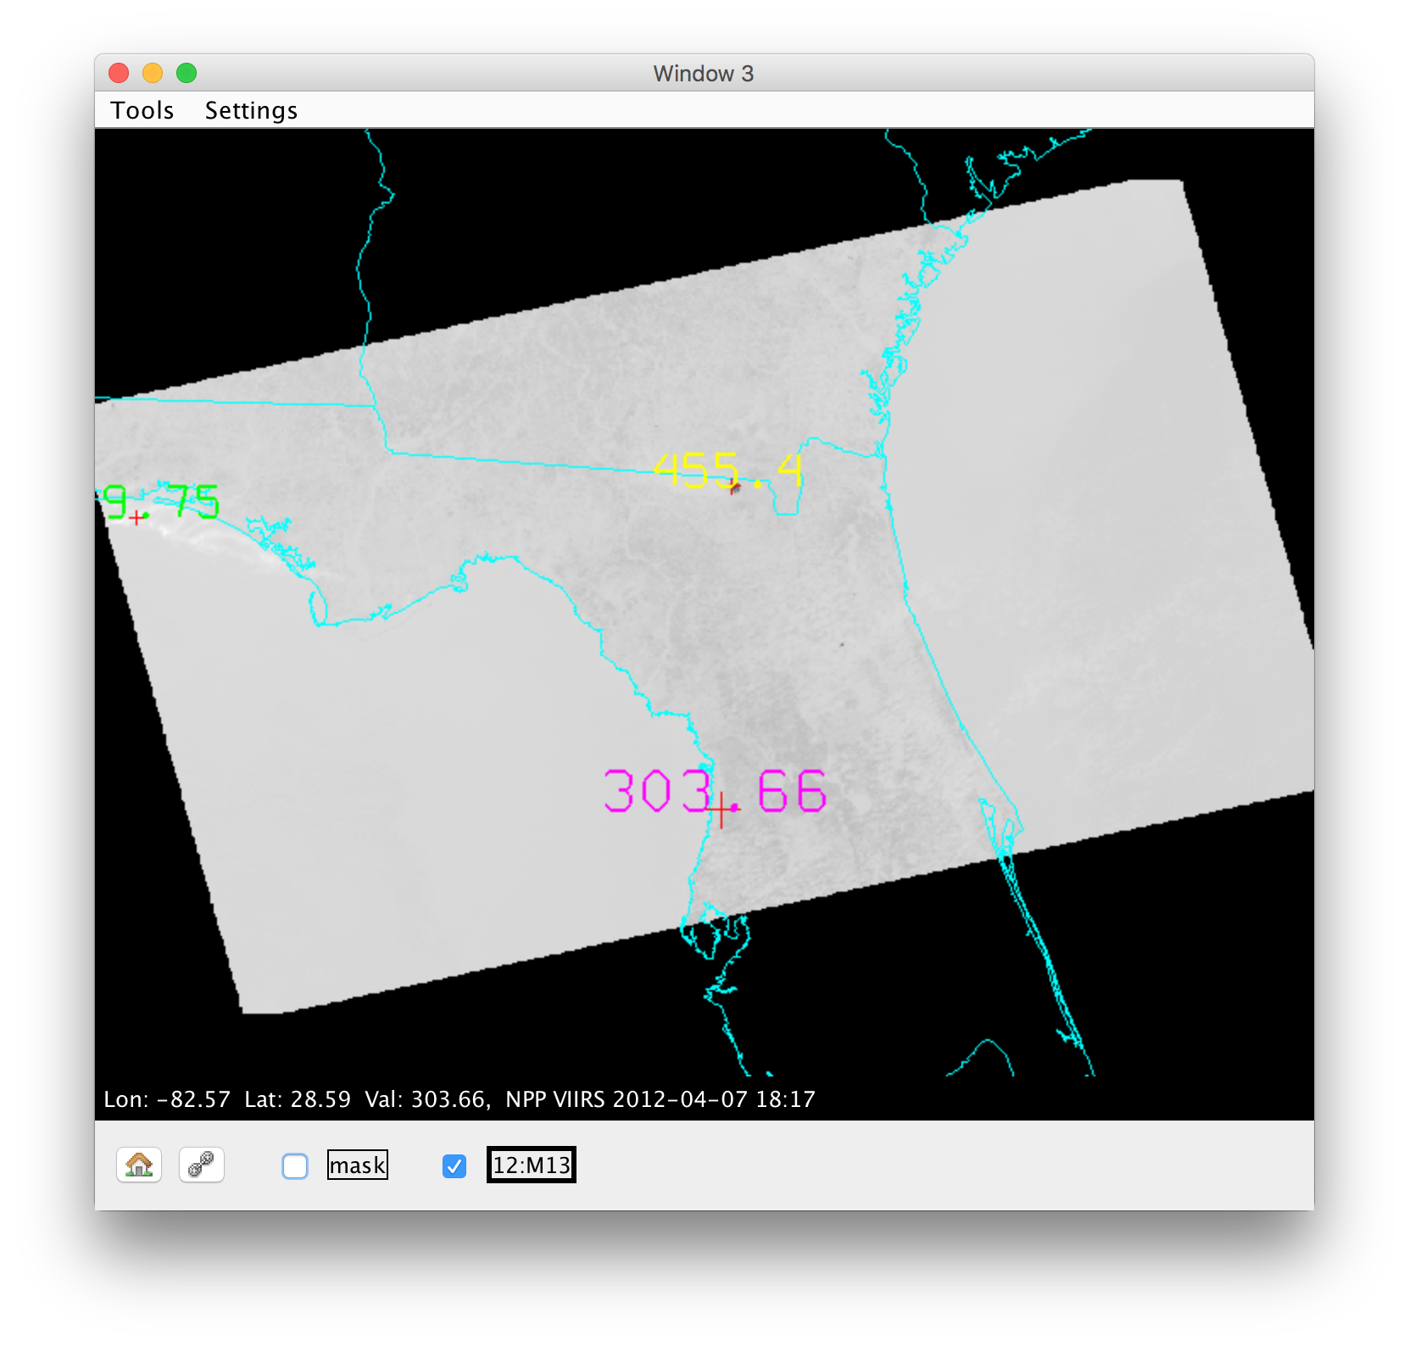
Fire Detection Algorithm
MODIS Fire Detection Algorithm:
Tests a pixel to see if:
1. The 4 μm brightness temperature (BT4) > 310 K
and
2. The difference of 4 μm minus 11 μm > 10K
This can be implemented on the VIIRS Data:
BTDIFF4-11 ((M-Band 13 (4.0 μm) – M-Band 15 (10.7 μm)) > 10 K.

Slide 36
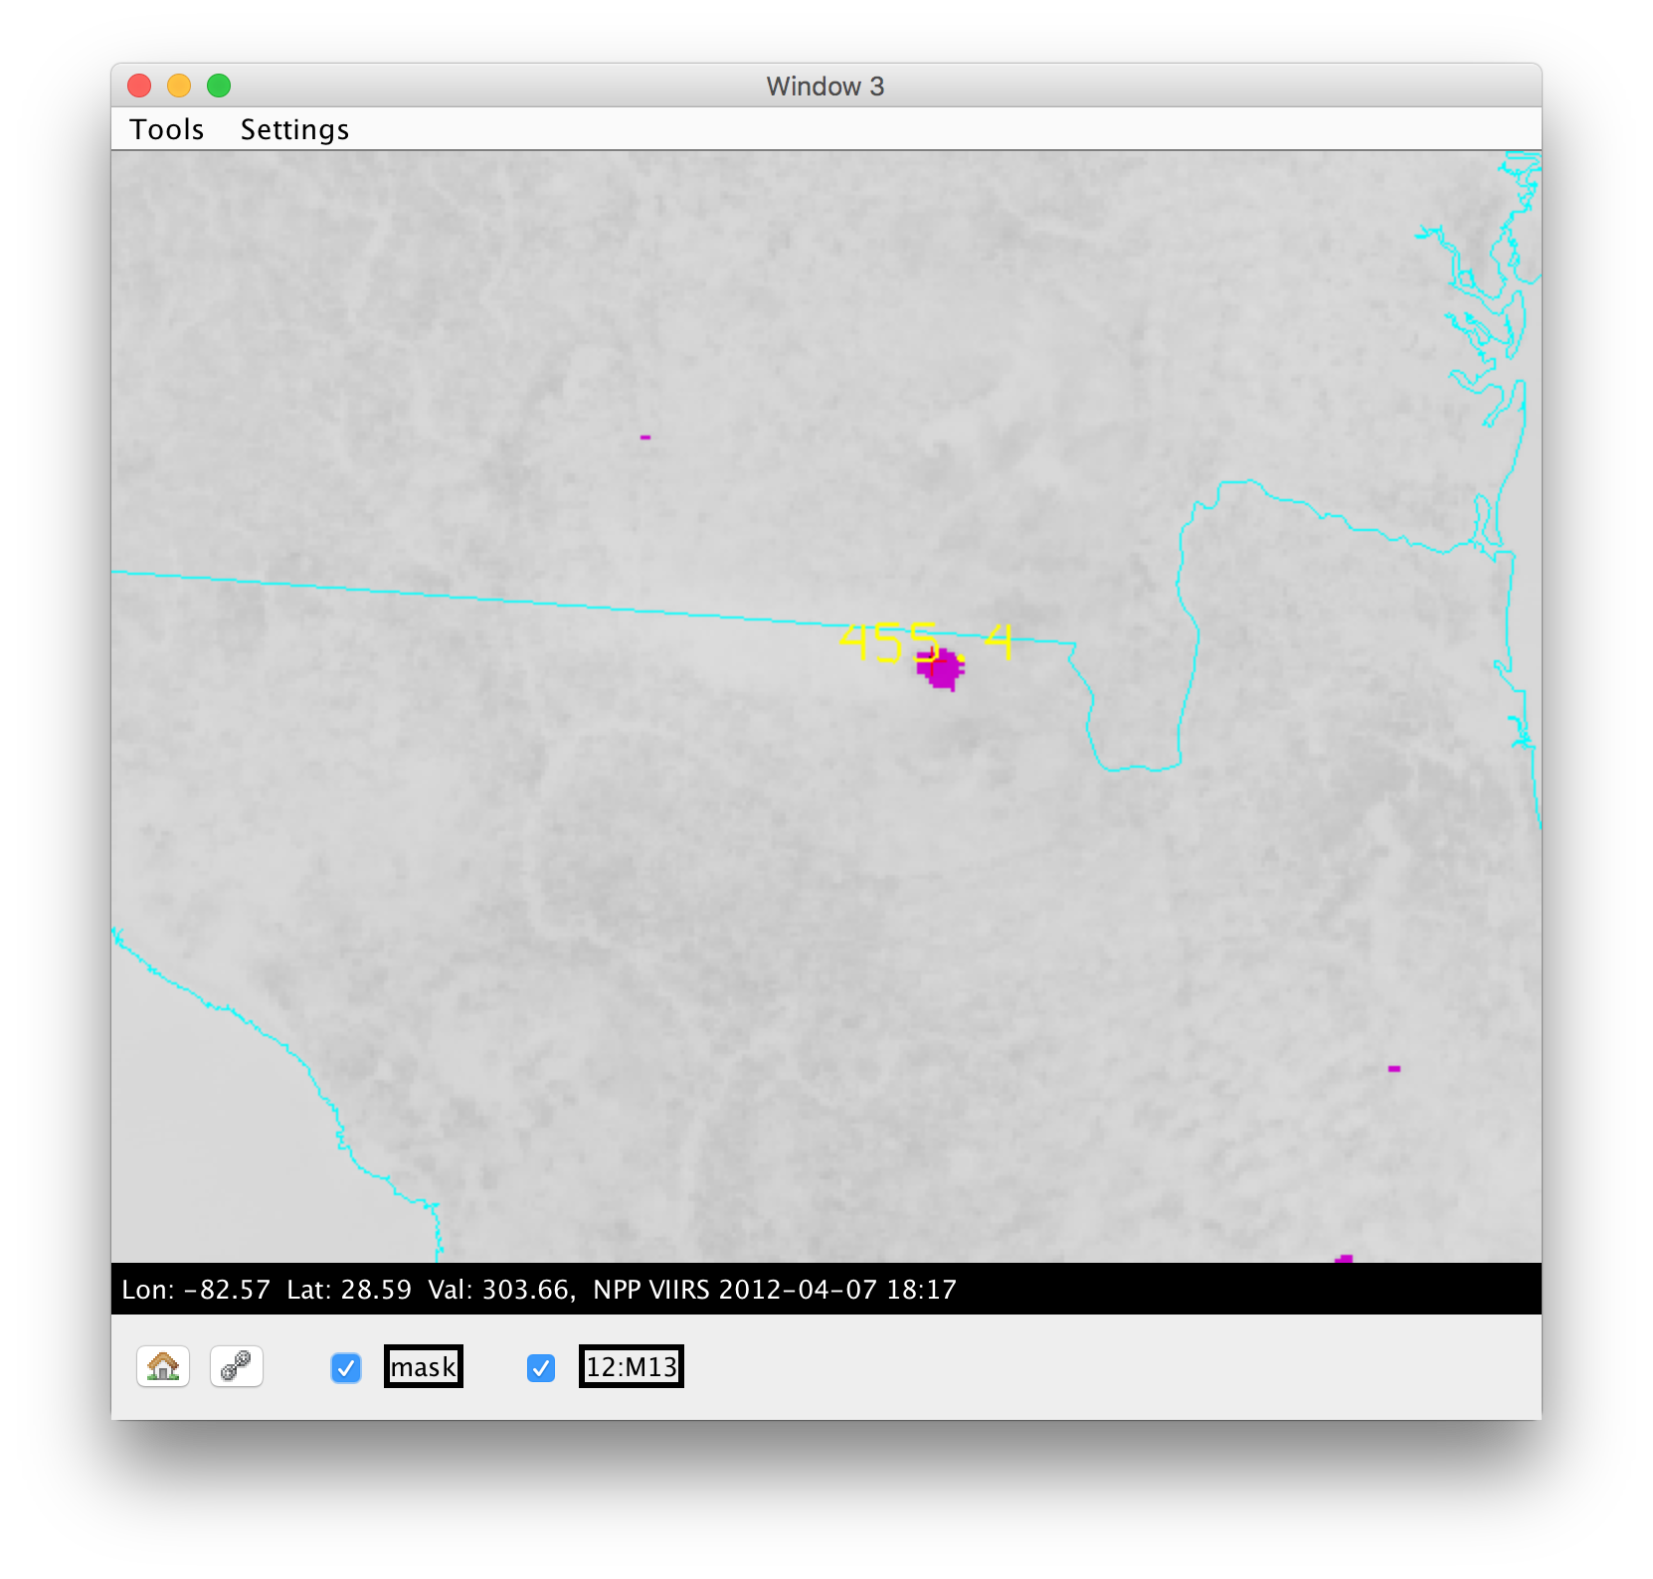
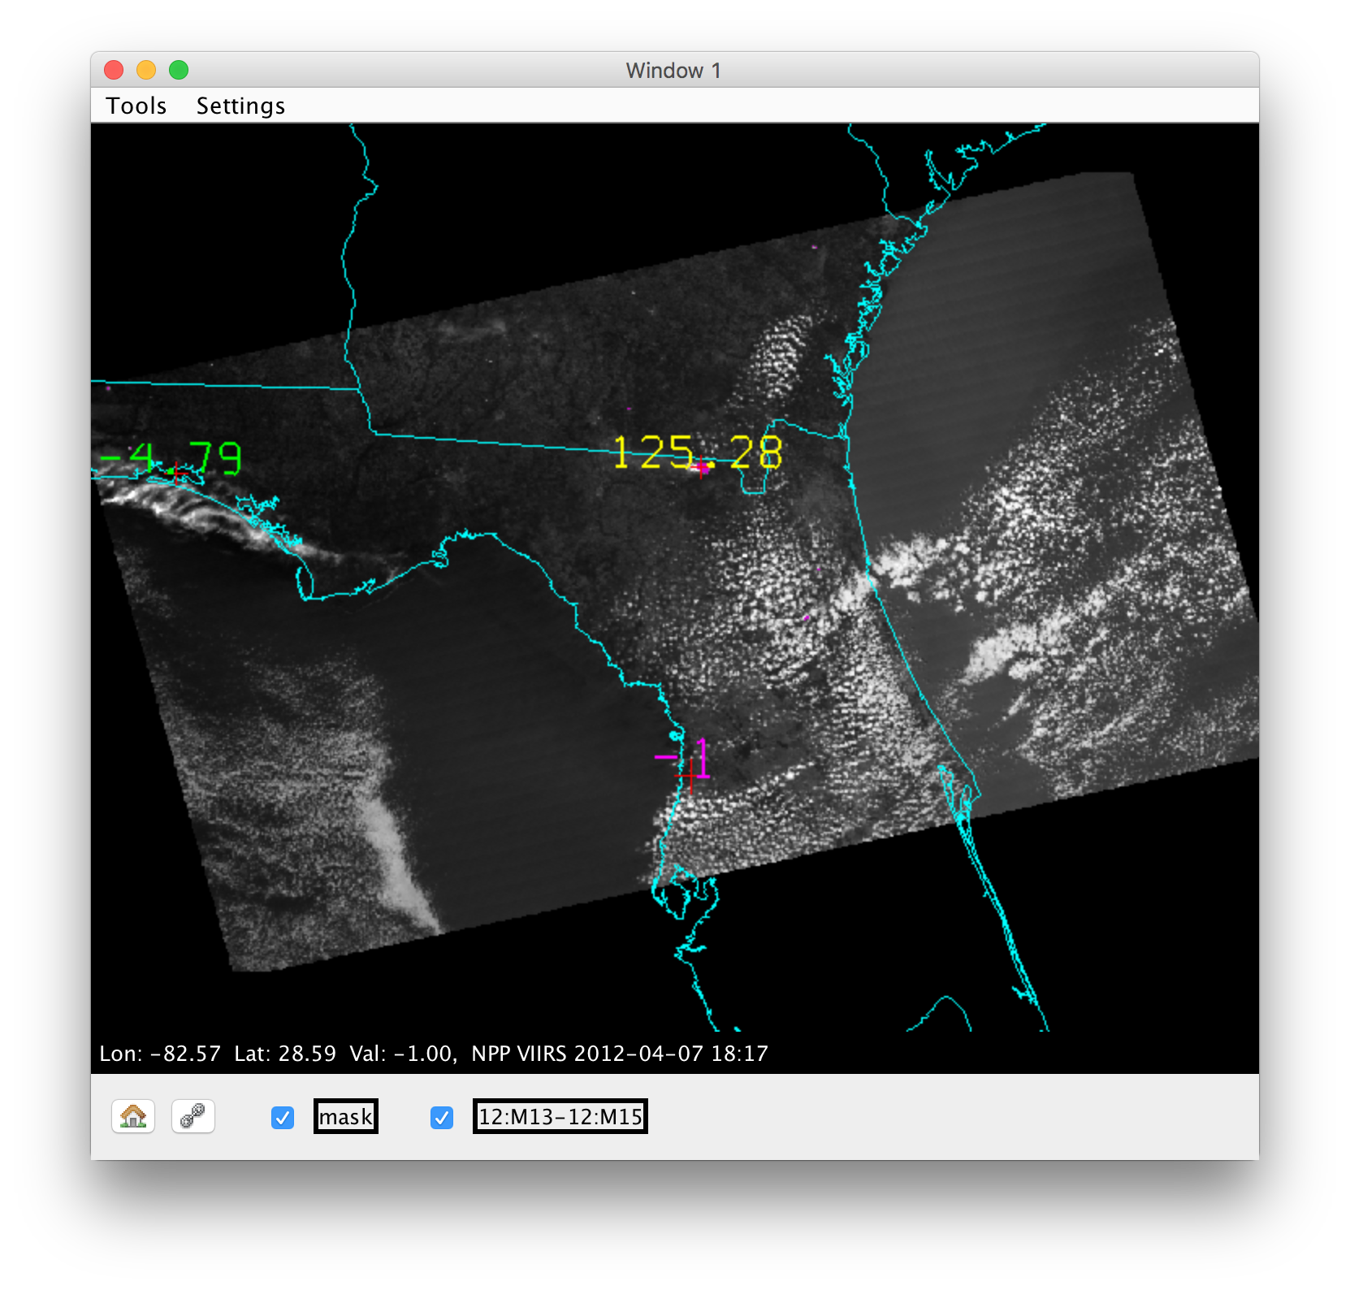
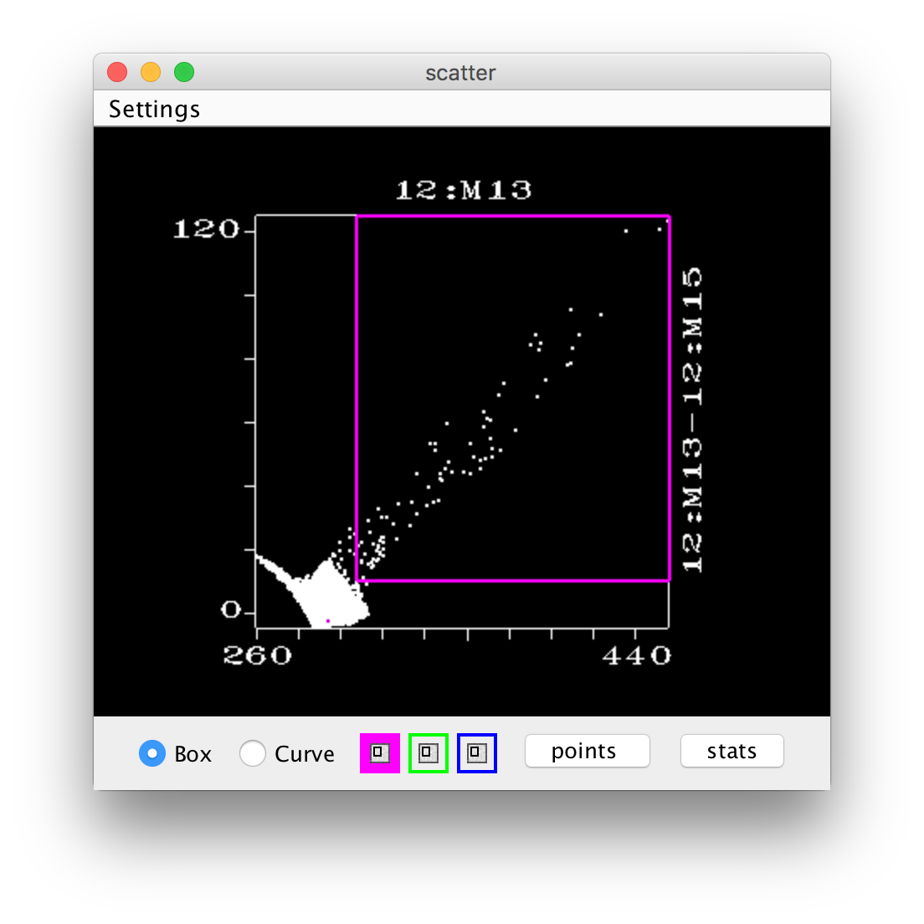
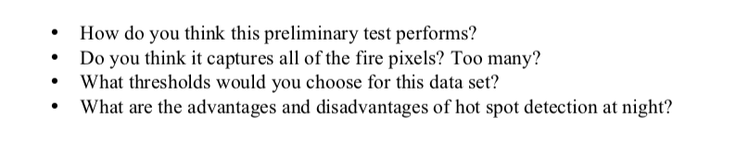
Fire Detection Algorithm
MODIS Fire Detection Algorithm:
Tests a pixel to see if:
1. The 4 μm brightness temperature (BT4) > 310 K
and
2. The difference of 4 μm minus 11 μm > 10K
This can be implemented on the VIIRS Data:
BTDIFF4-11 ((M-Band 13 (4.0 μm) – M-Band 15 (10.7 μm)) > 10 K.

Slide 37
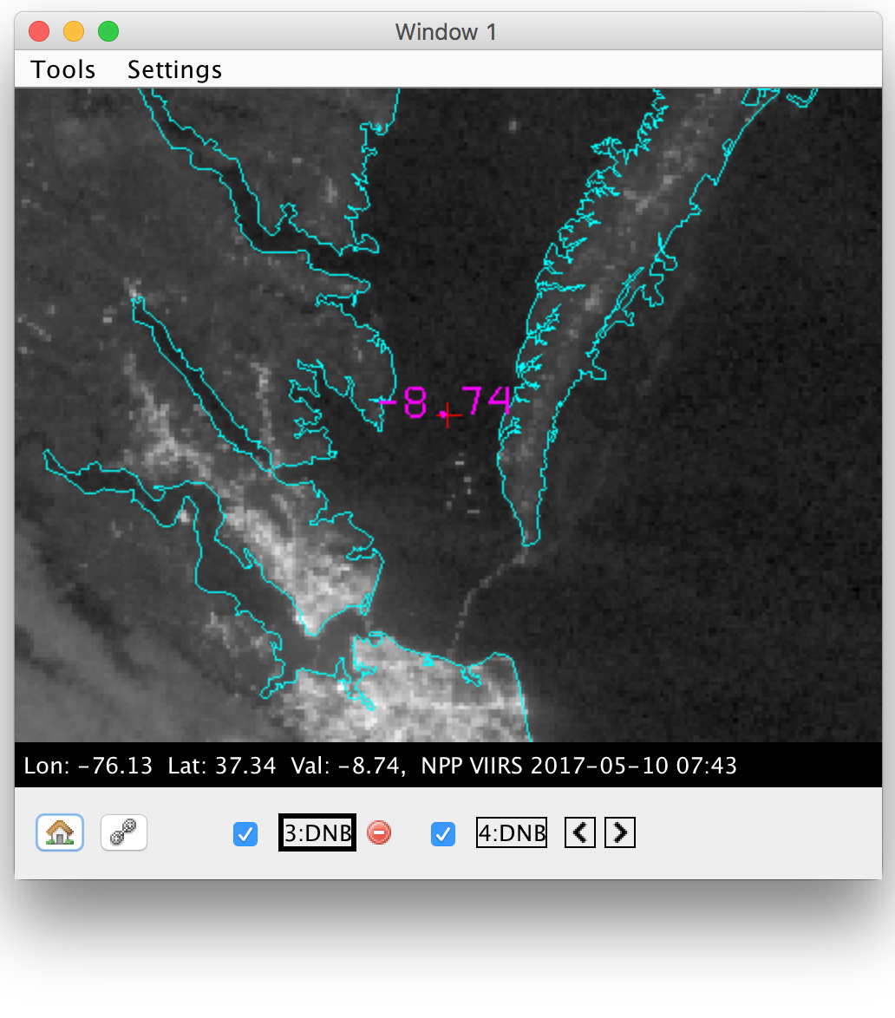
Impart Local Knowledge
VIIRS DNB can identify many features at nighttime.
Ships
What is the unidentified feature?
Students Identify: Chesapeake Bay Bridge Tunnel
???
City Lights

Slide 38
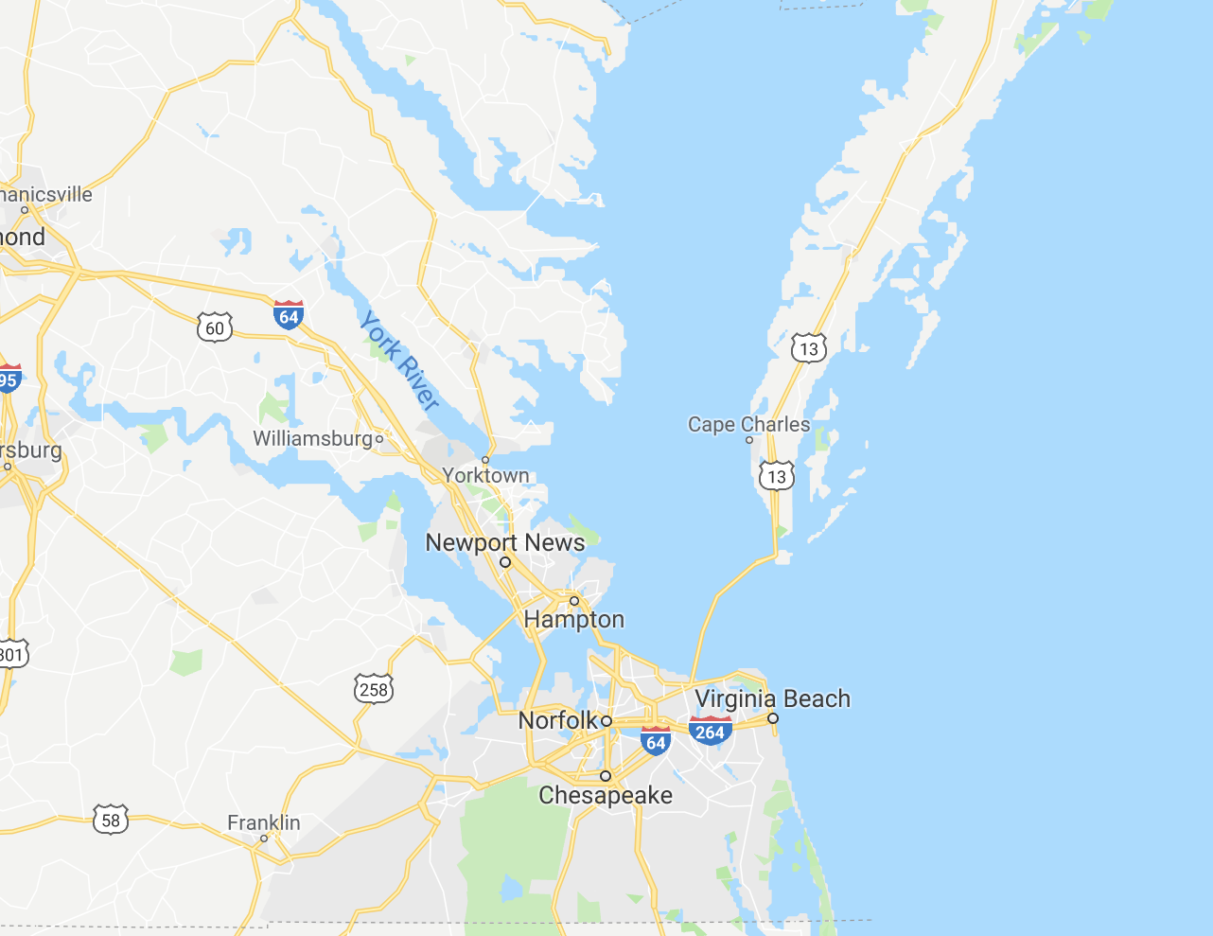
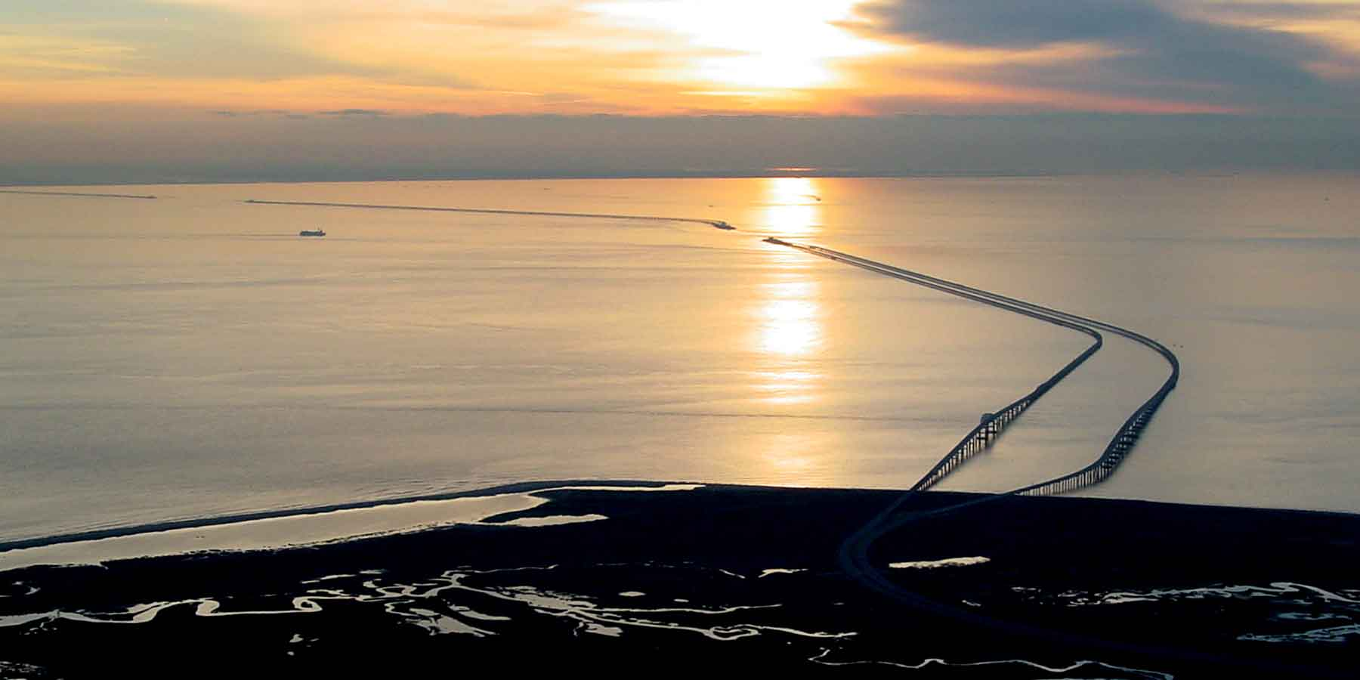
Google Map Verification

Slide 39
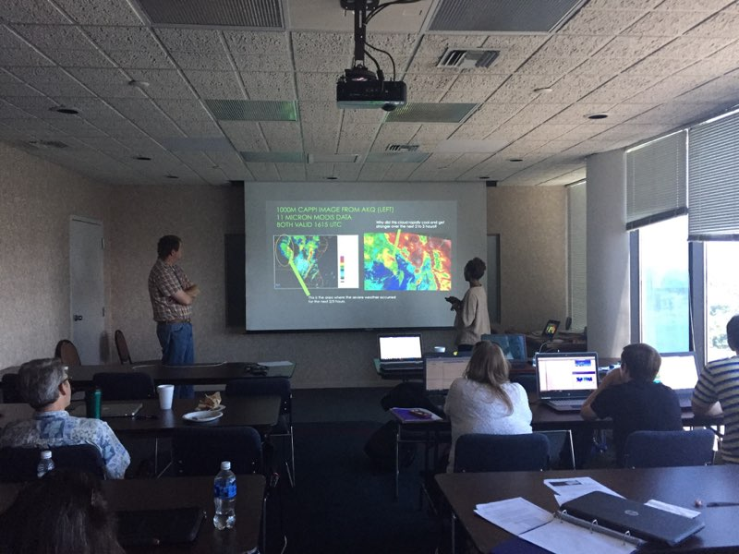
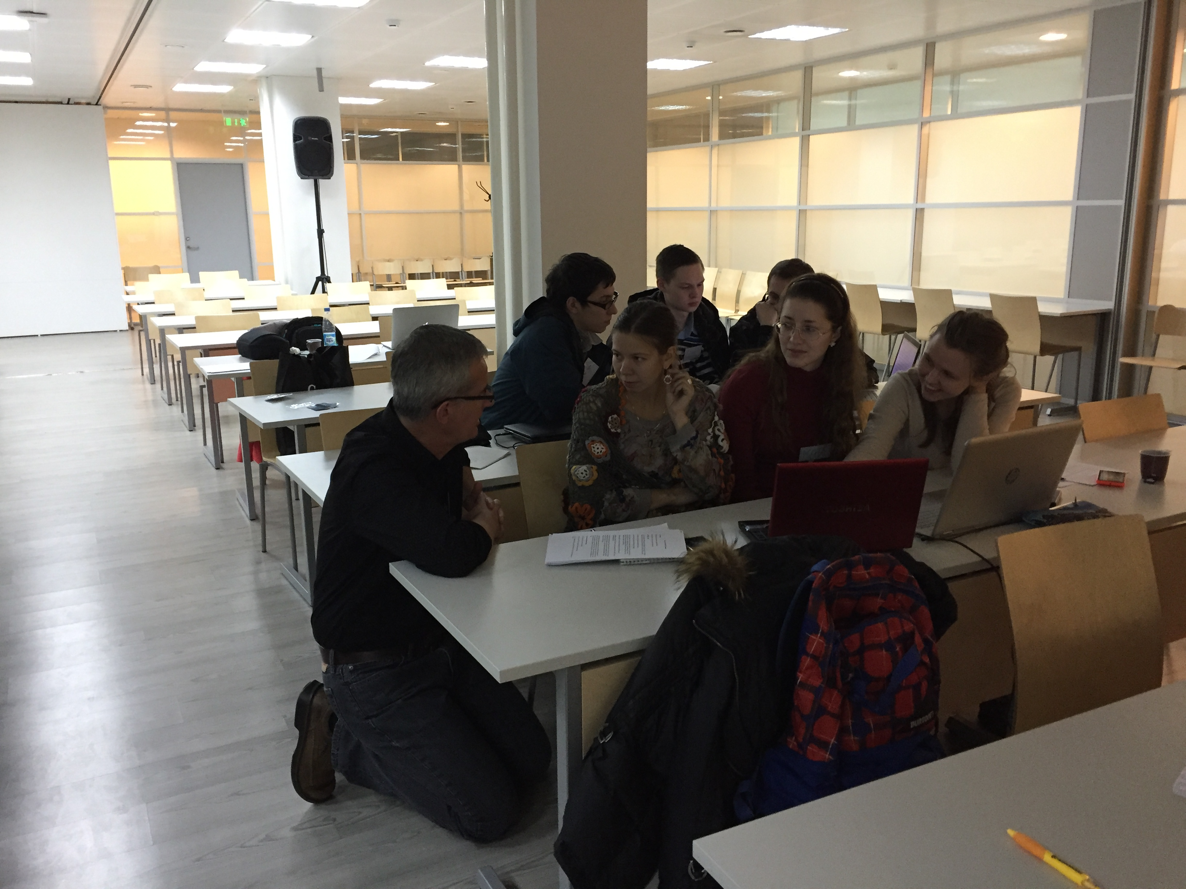
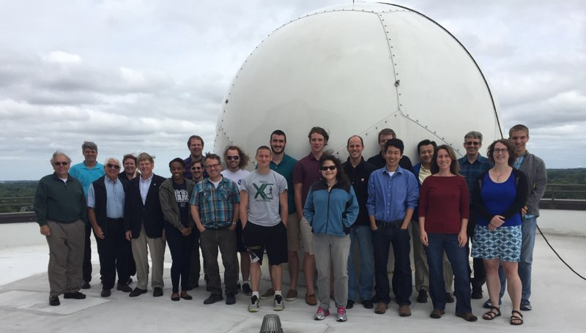
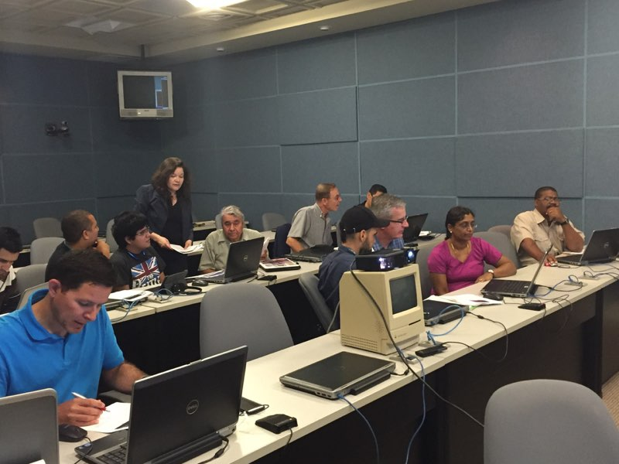
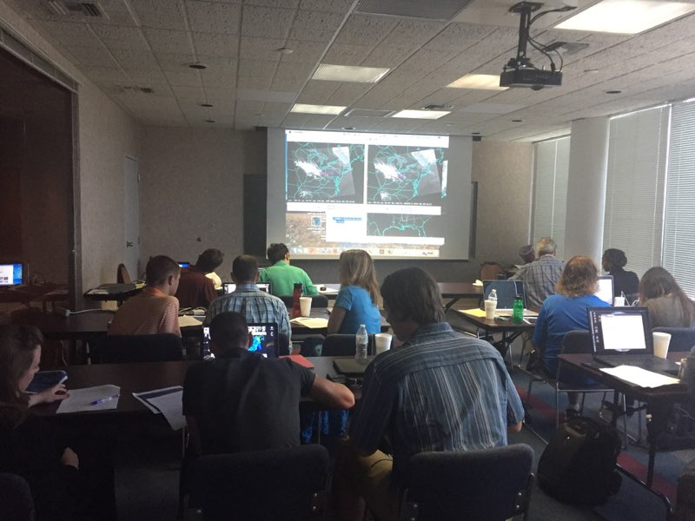

Slide 40
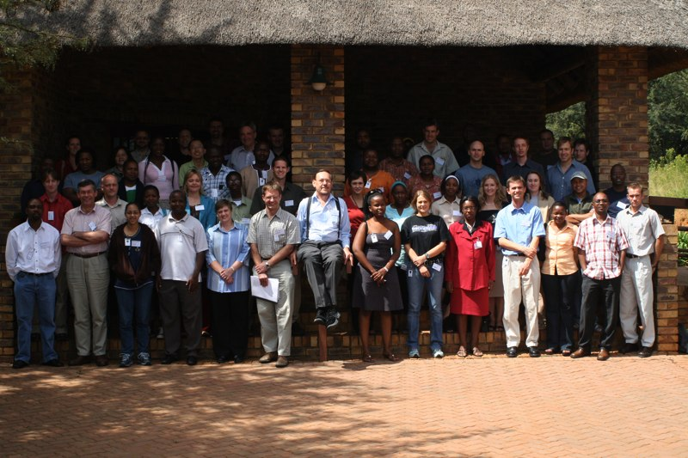
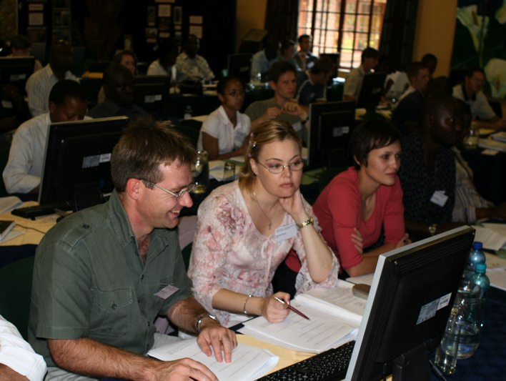
Are they useful?
Dr. Sanmei Li – Attended training course in Nanjing 2004.
  Now Assistant Professor at George Mason University, developer of the CSPP VIIRS Flood software package.
Dr. Nadia Smith – Attended training course in 2007 in South Africa
  Now: Subject Matter Expert on the science and application of Satellite Soundings for NOAA JPSS Program. Previously, researcher at SSEC.

Slide 41
Conclusions
In person, face-to-face training is important for fostering future working relationships.
A robust software tool for labs is essential for successful labs and for students to understand material.
Labs catered to workshop-specific locations invite opportunity for “local knowledge” to let students “teach the teachers”.
Case Study presentations help student use and improve their public speaking skills.
Availability of labs, lectures, data and software helps peak interest in current and future students.

Slide 42
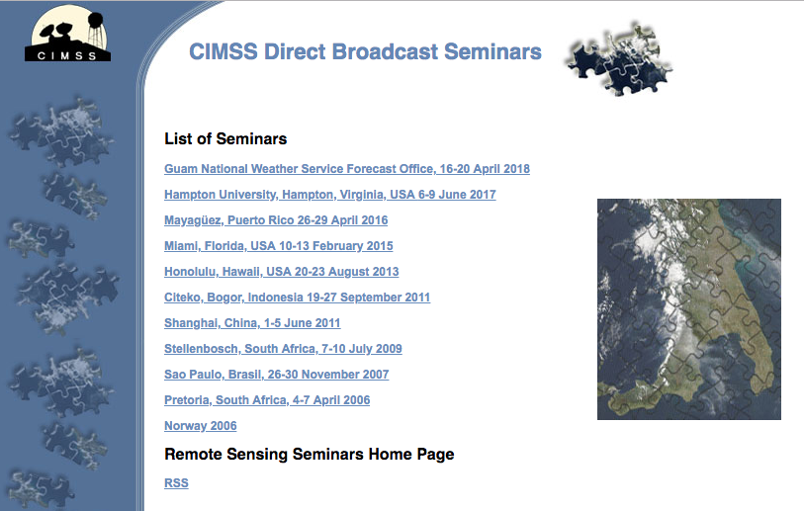
Contact
Email: jessica.braun@ssec.wisc.edu
Web:
https://cimss.ssec.wisc.edu/dbs
http://cimss.ssec.wisc.edu/cspp/npp_hydra2_v2.0.shtml

